Slide 1

Chapter 15
Transmission
Control
Protocol (TCP)
TCP/IP Protocol Suite
1
Copyright © The McGraw-Hill Companies, Inc. Permission required for reproduction or display.
Notes:
1

Slide 2
OBJECTIVES:
To introduce TCP as a protocol that provides reliable stream delivery service.
To define TCP features and compare them with UDP features.
To define the format of a TCP segment and its fields.
To show how TCP provides a connection-oriented service, and show the segments exchanged during connection establishment and connection termination phases.
To discuss the state transition diagram for TCP and discuss some scenarios.
To introduce windows in TCP that are used for flow and error control.
TCP/IP Protocol Suite
2
Notes:
2

Slide 3
OBJECTIVES (continued):
To discuss how TCP implements flow control in which the receive window controls the size of the send window.
To discuss error control and FSMs used by TCP during the data transmission phase.
To discuss how TCP controls the congestion in the network using different strategies.
To list and explain the purpose of each timer in TCP.
To discuss options in TCP and show how TCP can provide selective acknowledgment using the SACK option.
To give a layout and a simplified pseudocode for the TCP package.
TCP/IP Protocol Suite
3
Notes:
3

Slide 4
Chapter Outline
15.1 TCP Services
15.2 TCP Features
15.3 Segment
15.4 A TCP Connection
15.5 State Transition Diagram
15.6 Windows in TCP
15.7 Flow Control
15.8 Error Control
15.9 Congestion Control
15.10 TCP Timers
15.11 Options
15.12 TCP Package
TCP/IP Protocol Suite
4
Notes:
4

Slide 5
15-1 TCP SERVICES
Figure 15.1 shows the relationship of TCP to the other protocols in the TCP/IP protocol suite. TCP lies between the application layer and the network layer, and serves as the intermediary between the application programs and the network operations.
TCP/IP Protocol Suite
5
Notes:
5

Slide 6
Topics Discussed in the Section
Process-to-Process Communication
Stream Delivery Service
Full-Duplex Communication
Multiplexing and Demultiplexing
Connection-Oriented Service
Reliable Service
TCP/IP Protocol Suite
6
Notes:
6

Slide 7
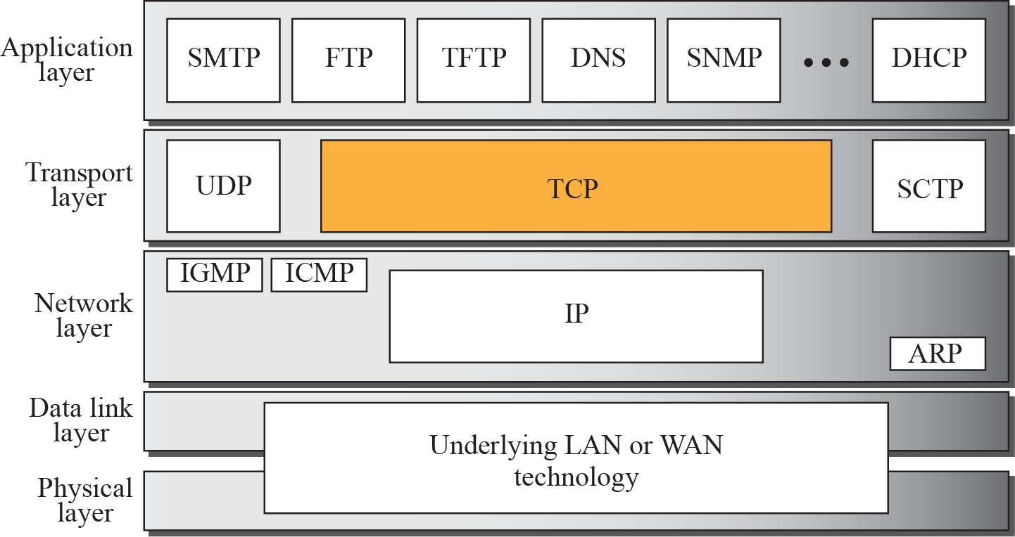
Figure 15.1 TCP/IP protocol suite
TCP/IP Protocol Suite
7
Notes:
7

Slide 8
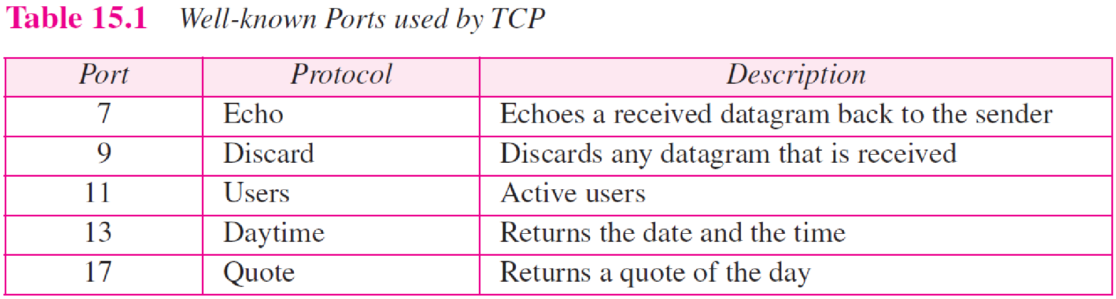
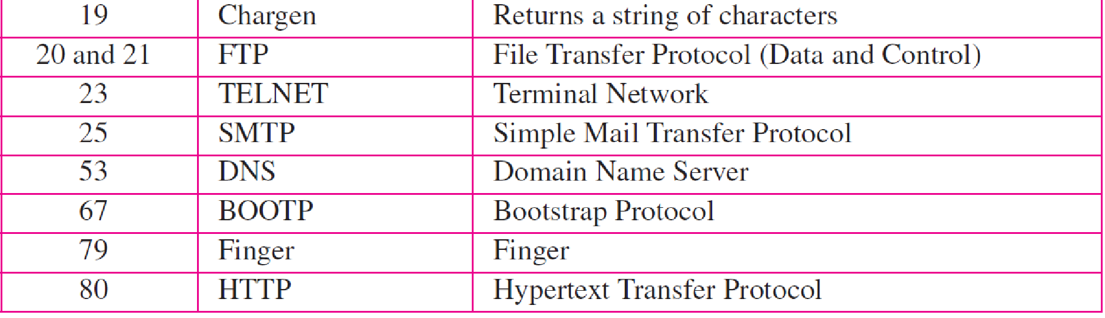
TCP/IP Protocol Suite
8
Notes:
8

Slide 9
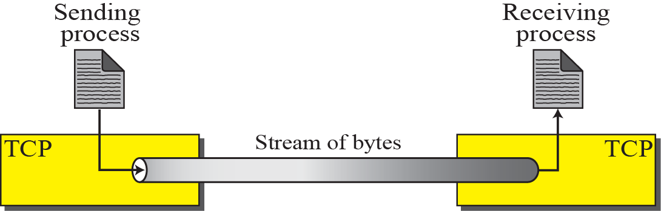
Figure 15.2 Stream delivery
TCP/IP Protocol Suite
9
Notes:
9

Slide 10
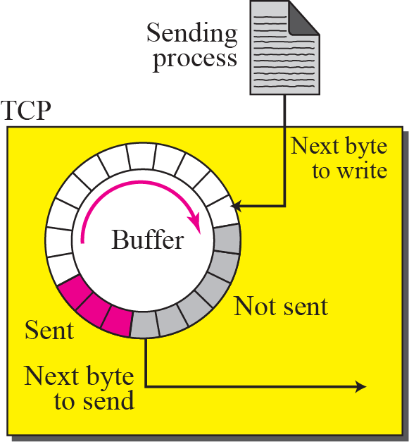
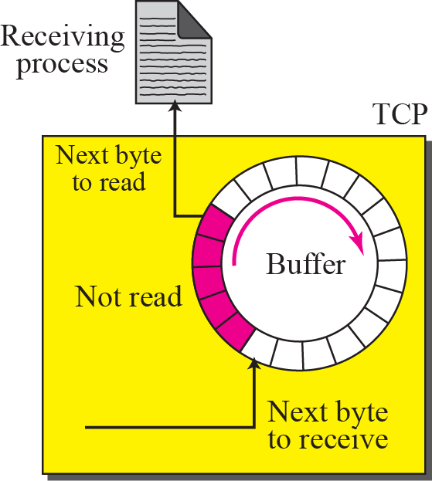
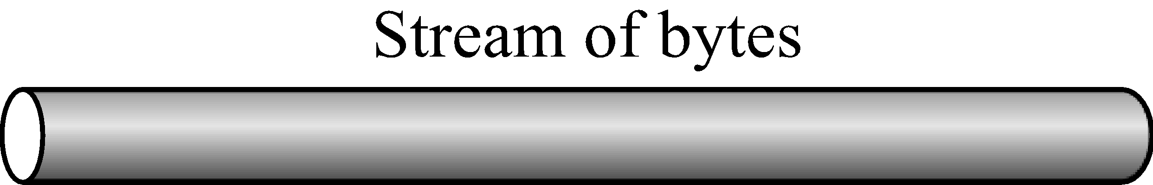
Figure 15.3 Sending and receiving buffers
TCP/IP Protocol Suite
10
Notes:
10

Slide 11
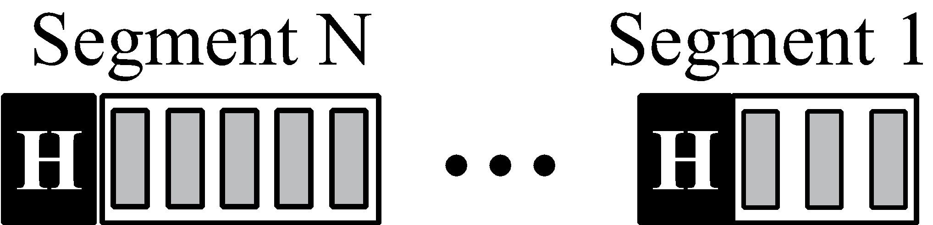
Figure 15.4 TCP segments
TCP/IP Protocol Suite
11
Notes:
11

Slide 12
15-2 TCP FEATURES
To provide the services mentioned in the previous section, TCP has several features that are briefly summarized in this section and discussed later in detail.
TCP/IP Protocol Suite
12
Notes:
12

Slide 13
Topics Discussed in the Section
Numbering System
Flow Control
Error Control
Congestion Control
TCP/IP Protocol Suite
13
Notes:
13

Slide 14

Note
The bytes of data being transferred in each connection are numbered by TCP.
The numbering starts with an arbitrarily generated number.
TCP/IP Protocol Suite
14
Notes:
14

Slide 15
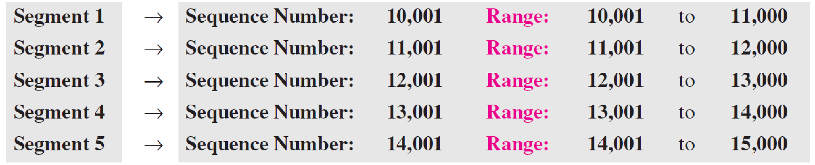
Example 15.1
Suppose a TCP connection is transferring a file of 5,000 bytes. The first byte is numbered 10,001. What are the sequence numbers for each segment if data are sent in five segments, each carrying 1,000 bytes?
Solution
The following shows the sequence number for each segment:
TCP/IP Protocol Suite
15
Notes:
15

Slide 16
Note
The value in the sequence number field of a segment defines the number assigned to the first data byte contained in that segment.
TCP/IP Protocol Suite
16
Notes:
16

Slide 17
Note
The value of the acknowledgment field in a segment defines the number of the next byte a party expects to receive.
The acknowledgment number is cumulative.
TCP/IP Protocol Suite
17
Notes:
17

Slide 18
15-3 SEGMENT
Before discussing TCP in more detail, let us discuss the TCP packets themselves. A packet in TCP is called a segment.
TCP/IP Protocol Suite
18
Notes:
18

Slide 19
Topics Discussed in the Section
Format
Encapsulation
TCP/IP Protocol Suite
19
Notes:
19

Slide 20
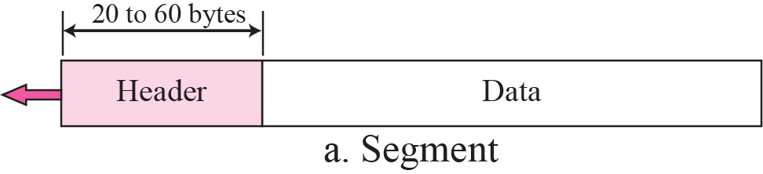
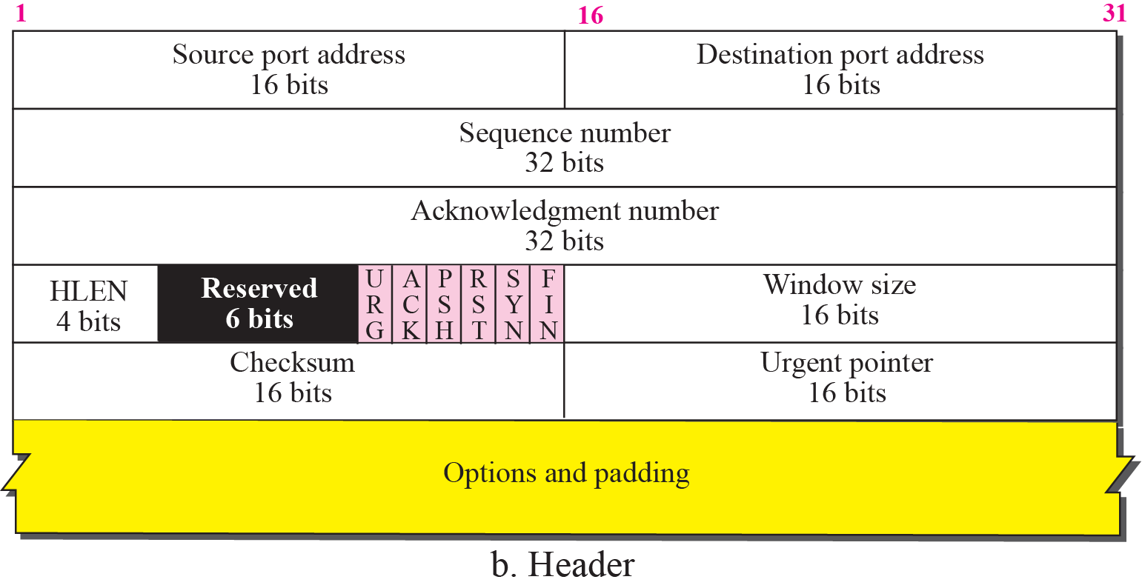
Figure 15.5 TCP segment format
TCP/IP Protocol Suite
20
Notes:
20

Slide 21
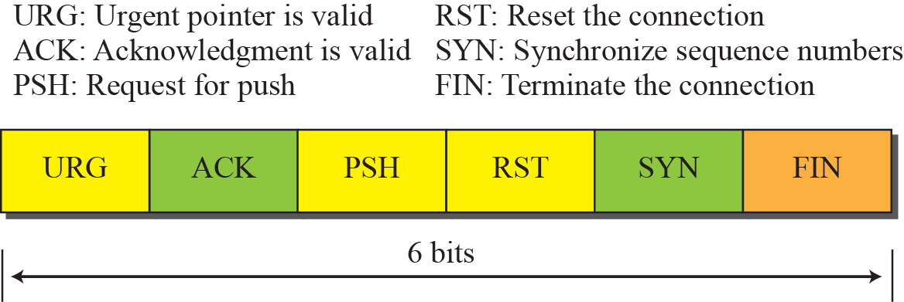
Figure 15.6 Control field
TCP/IP Protocol Suite
21
Notes:
21

Slide 22
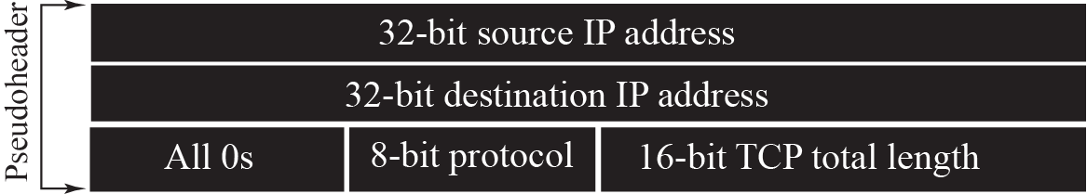
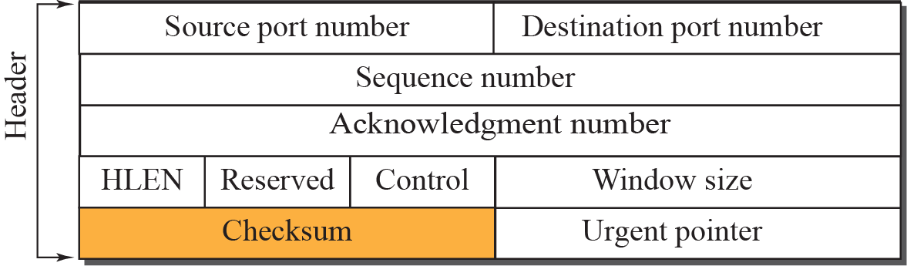

Figure 15.7 Pseudoheader added to the TCP segment
TCP/IP Protocol Suite
22
Notes:
22

Slide 23
Note
The use of the checksum in TCP is mandatory.
TCP/IP Protocol Suite
23
Notes:
23

Slide 24

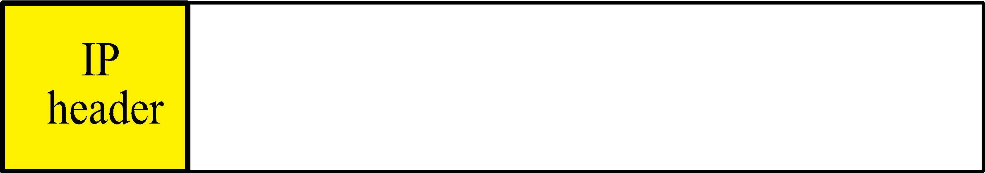

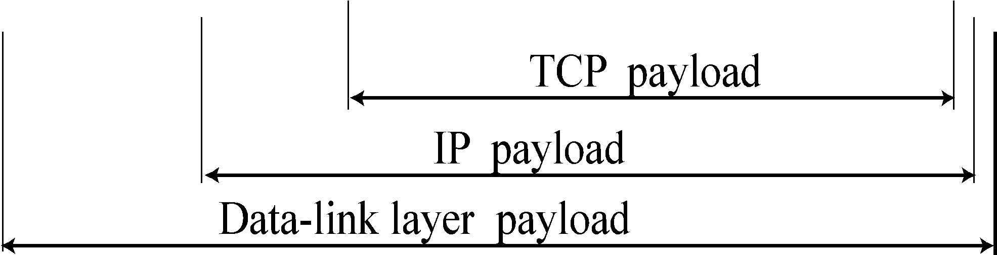
Figure 15.8 Encapsulation
TCP/IP Protocol Suite
24
Notes:
24

Slide 25
15-4 A TCP CONNECTION
TCP is connection-oriented. It establishes a virtual path between the source and destination. All of the segments belonging to a message are then sent over this virtual path. You may wonder how TCP, which uses the services of IP, a connectionless protocol, can be connection-oriented. The point is that a TCP connection is virtual, not physical. TCP operates at a higher level. TCP uses the services of IP to deliver individual segments to the receiver, but it controls the connection itself. If a segment is lost or corrupted, it is retransmitted.
TCP/IP Protocol Suite
25
Notes:
25

Slide 26
Topics Discussed in the Section
Connection Establishment
Data Transfer
Connection Termination
Connection Reset
TCP/IP Protocol Suite
26
Notes:
26

Slide 27
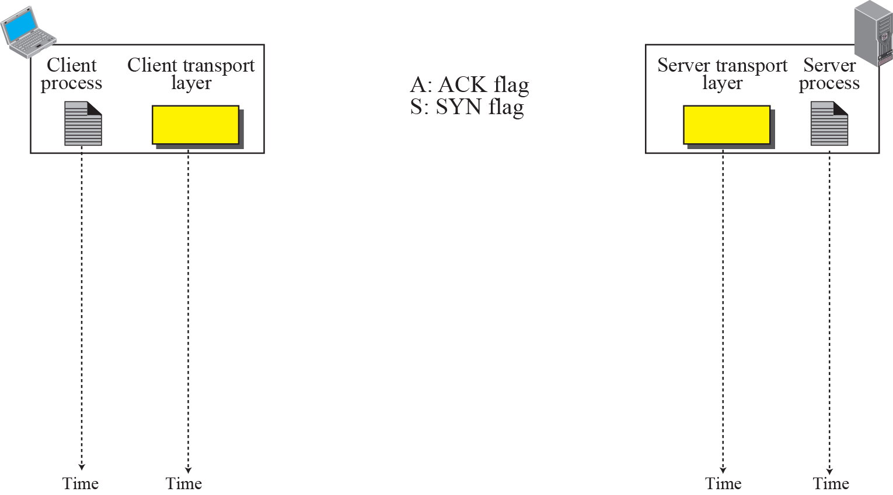


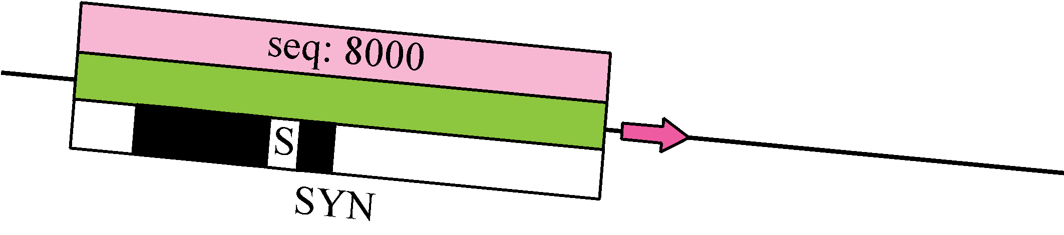
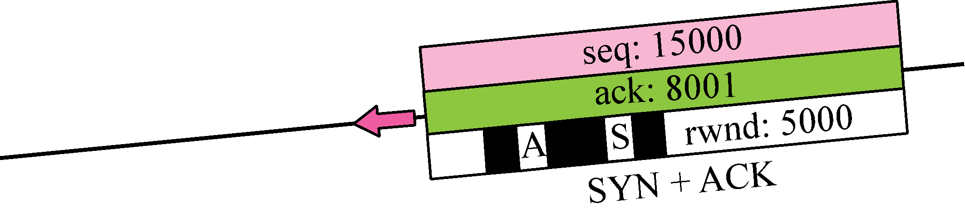
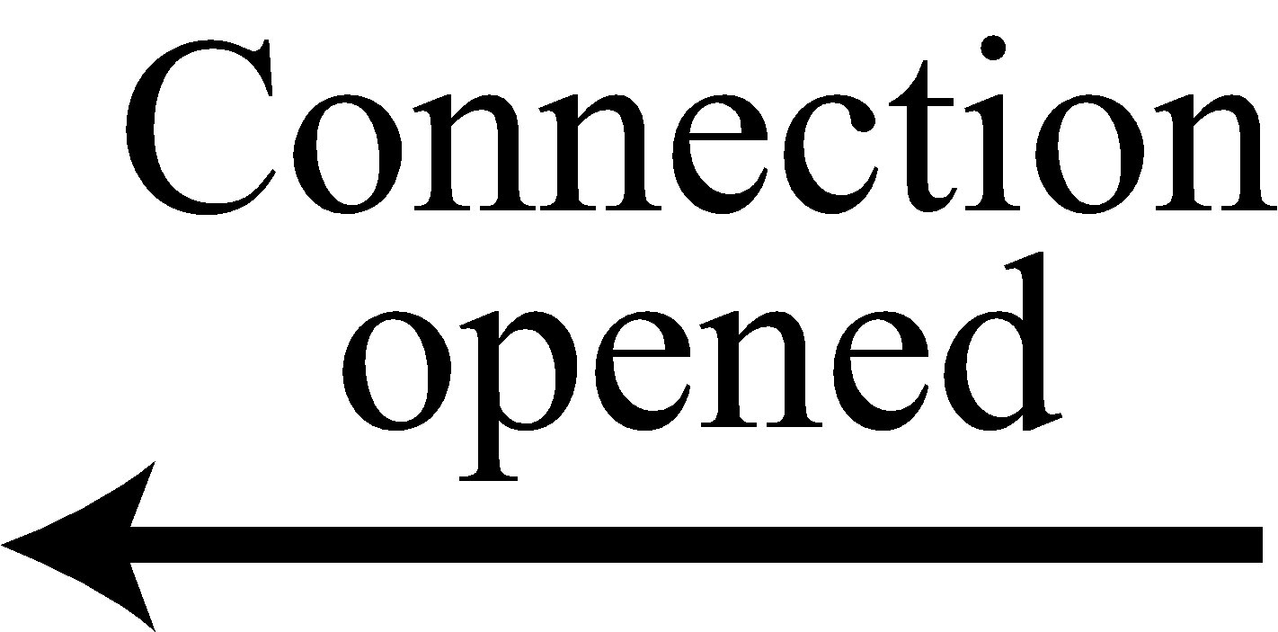
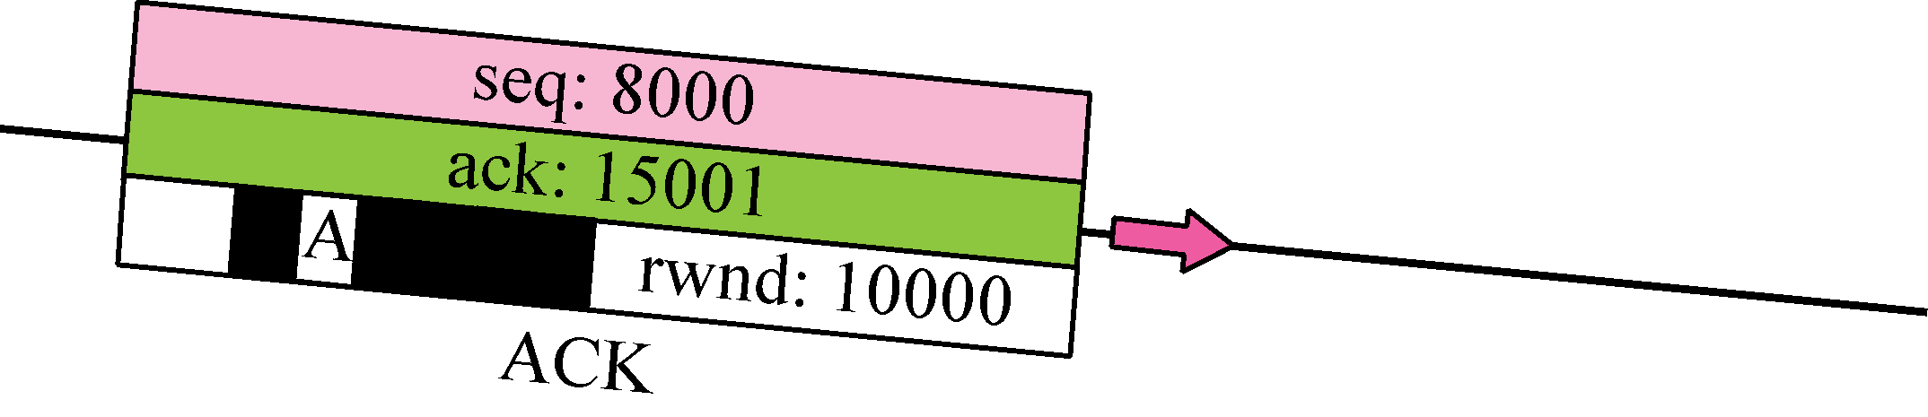

Figure 15.9 Connection establishment using three-way handshake
Means “no data” !
seq: 8001 if piggybacking
TCP/IP Protocol Suite
27
Notes:
27

Slide 28
Note
A SYN segment cannot carry data, but it consumes one sequence number.
TCP/IP Protocol Suite
28
Notes:
28

Slide 29
Note
A SYN + ACK segment cannot carry data, but does consume one sequence number.
TCP/IP Protocol Suite
29
Notes:
29

Slide 30
Note
An ACK segment, if carrying no data, consumes no sequence number.
TCP/IP Protocol Suite
30
Notes:
30

Slide 31
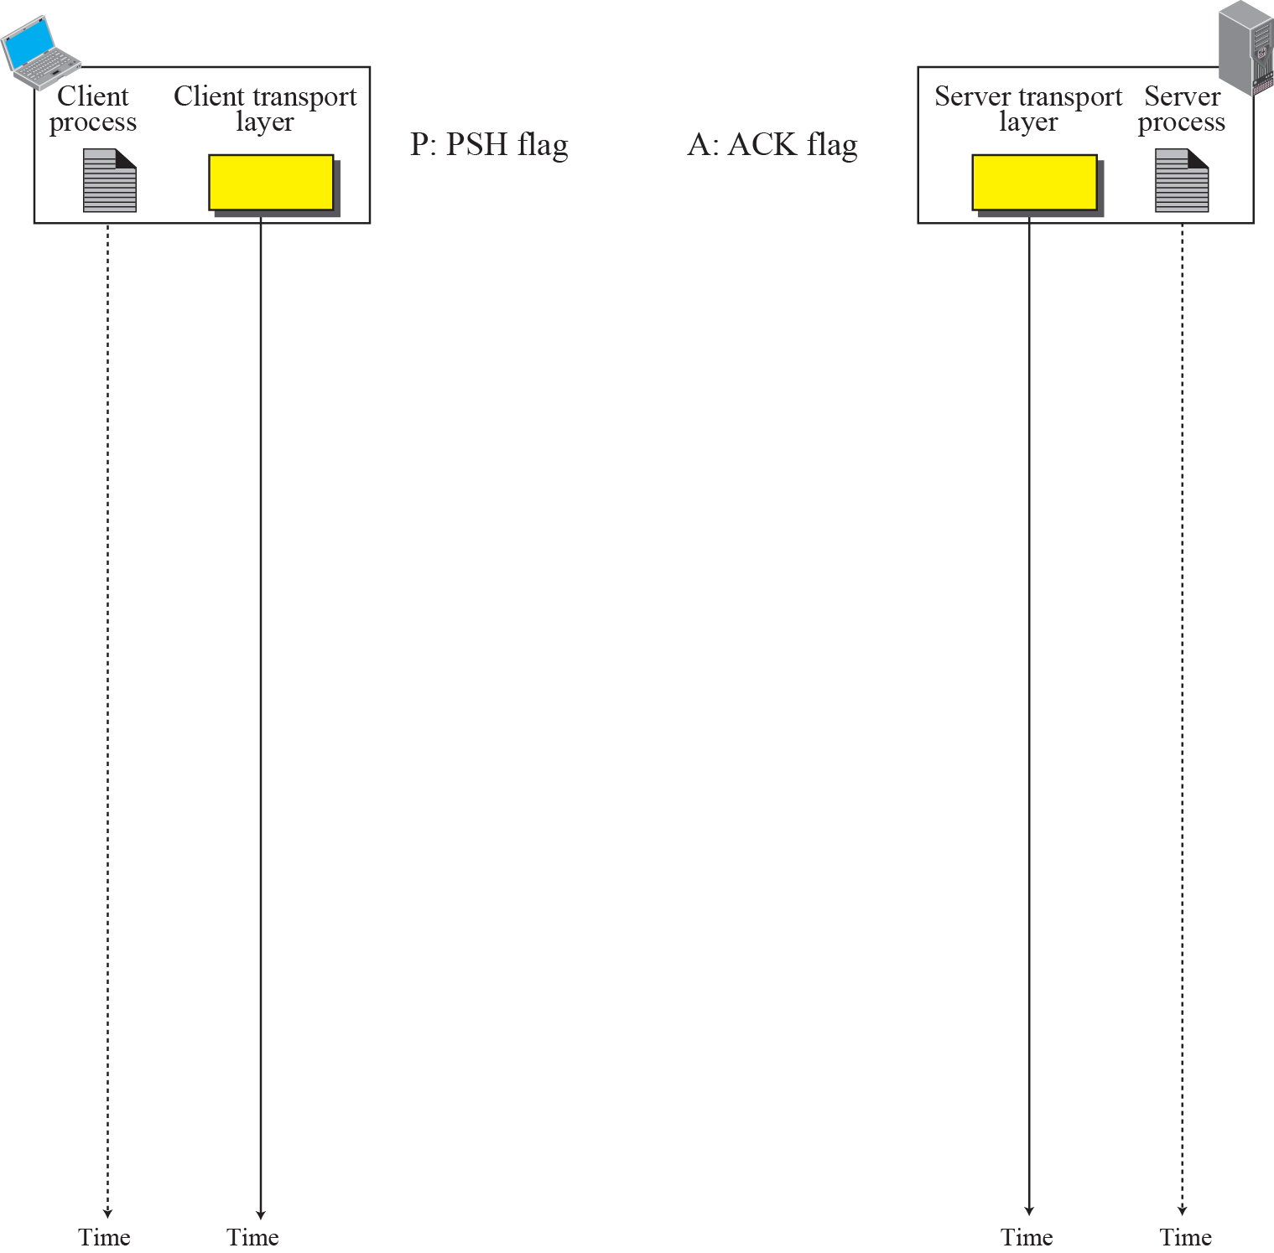
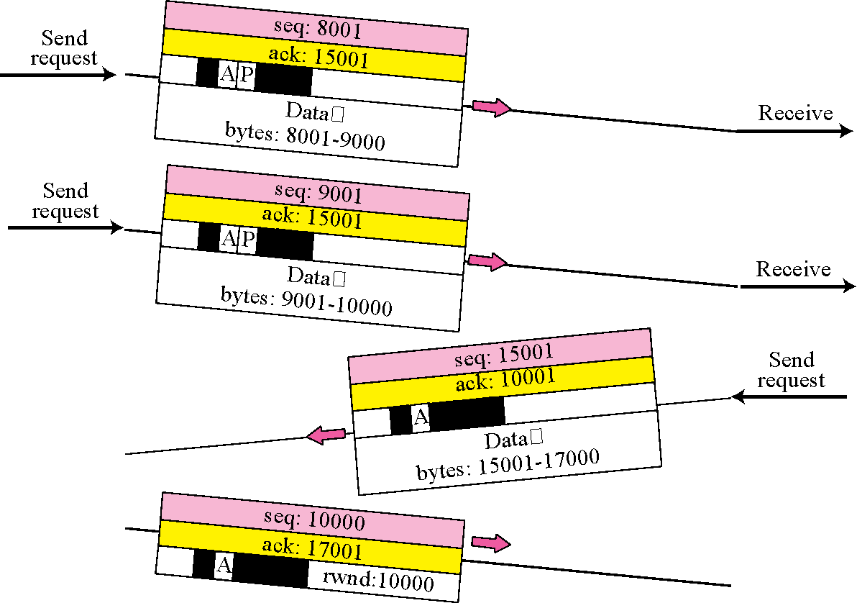

Figure 15.10 Data Transfer
Pushing data
Urgent data
TCP/IP Protocol Suite
31
Notes:
31

Slide 32
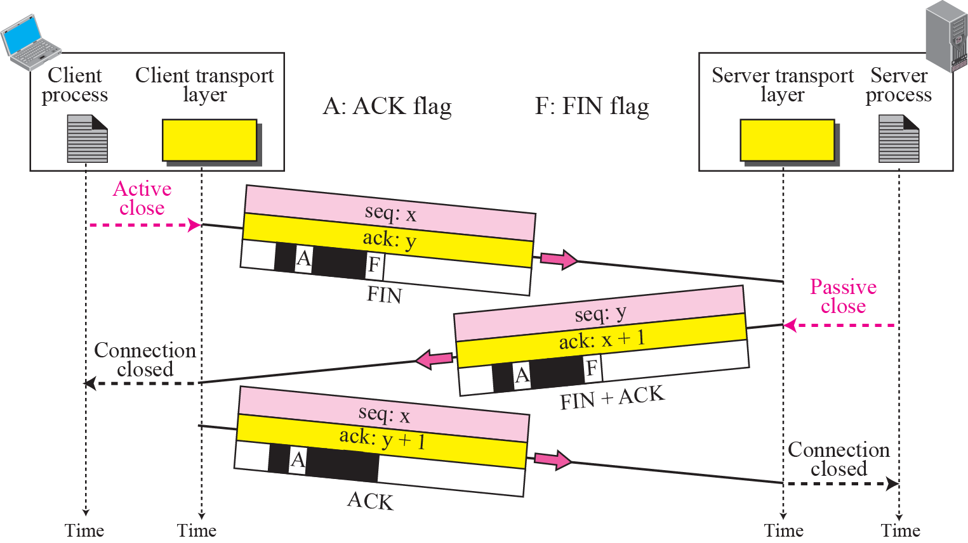
Figure 15.11 Connection termination using three-way handshake
TCP/IP Protocol Suite
32
Notes:
32

Slide 33
Note
The FIN segment consumes one sequence number if it does not carry data.
TCP/IP Protocol Suite
33
Notes:
33

Slide 34
Note
The FIN + ACK segment consumes one sequence number if it does not carry data.
TCP/IP Protocol Suite
34
Notes:
34

Slide 35
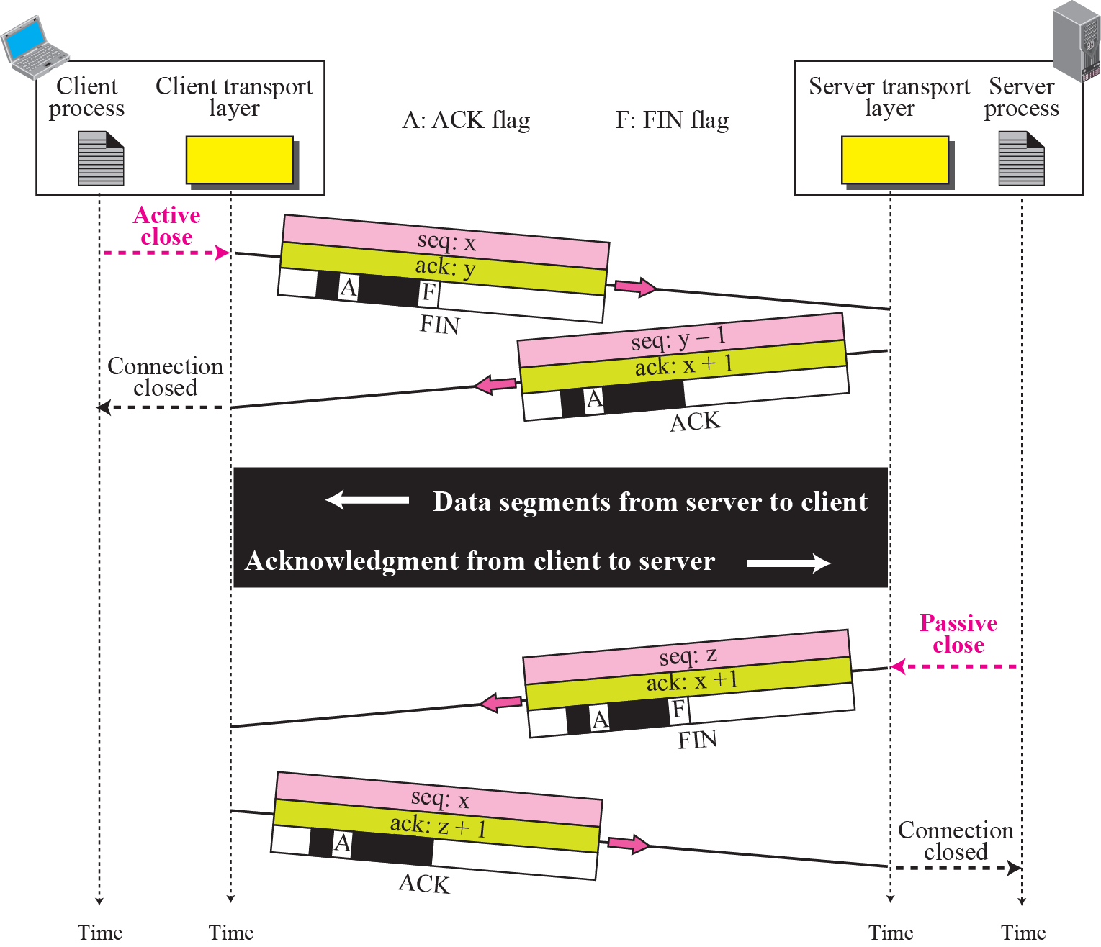
Figure 15.12 Half-Close
TCP/IP Protocol Suite
35
Notes:
35

Slide 36
15-5 STATE TRANSITION DIAGRAM
To keep track of all the different events happening during connection establishment, connection termination, and data transfer, TCP is specified as the finite state machine shown in Figure 15.13.
TCP/IP Protocol Suite
36
Notes:
36

Slide 37
Topics Discussed in the Section
Scenarios
TCP/IP Protocol Suite
37
Notes:
37

Slide 38
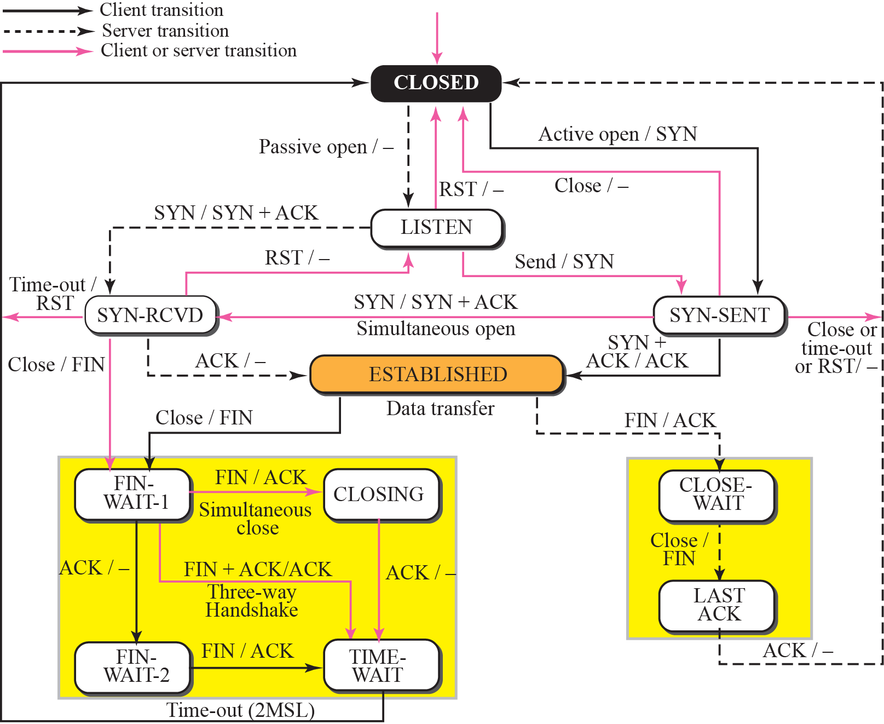
Figure 15.13 State transition diagram
TCP/IP Protocol Suite
38
Notes:
38

Slide 39
Note
The state marked as ESTBLISHED in the FSM is in fact two different
sets of states that the client and server undergo to transfer data.
TCP/IP Protocol Suite
39
Notes:
39

Slide 40
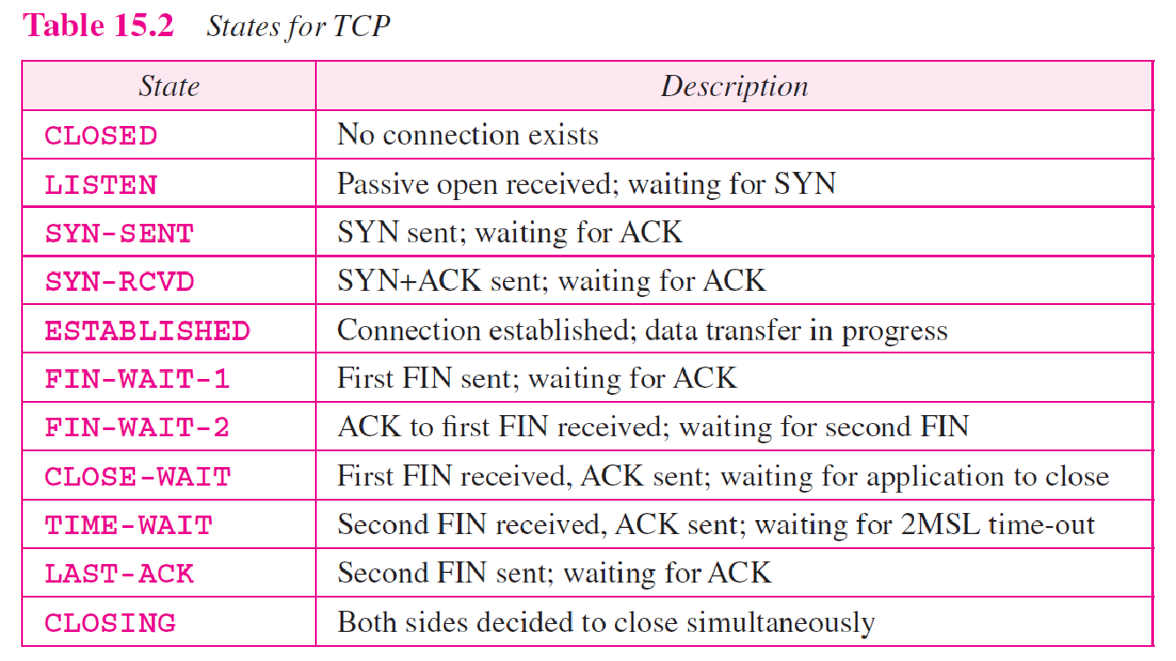
TCP/IP Protocol Suite
40
Notes:
40

Slide 41
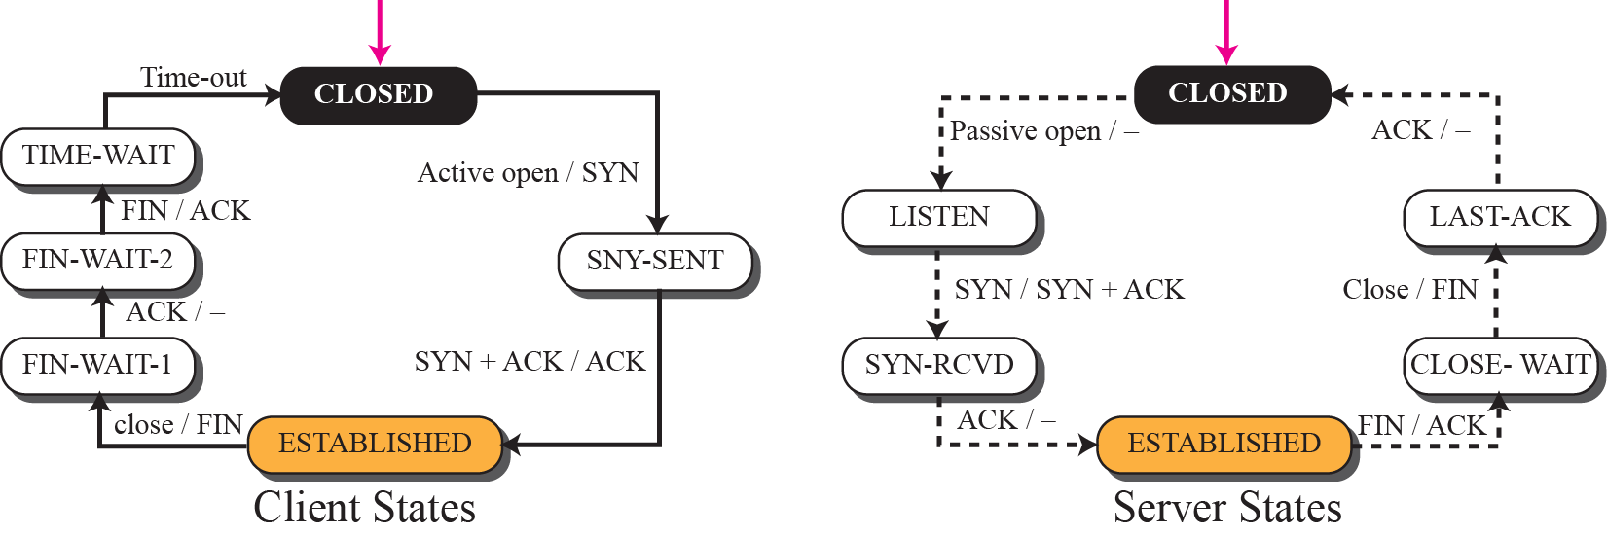
Figure 15.14 Transition diagram for connection and half-close termination
TCP/IP Protocol Suite
41
Notes:
41

Slide 42
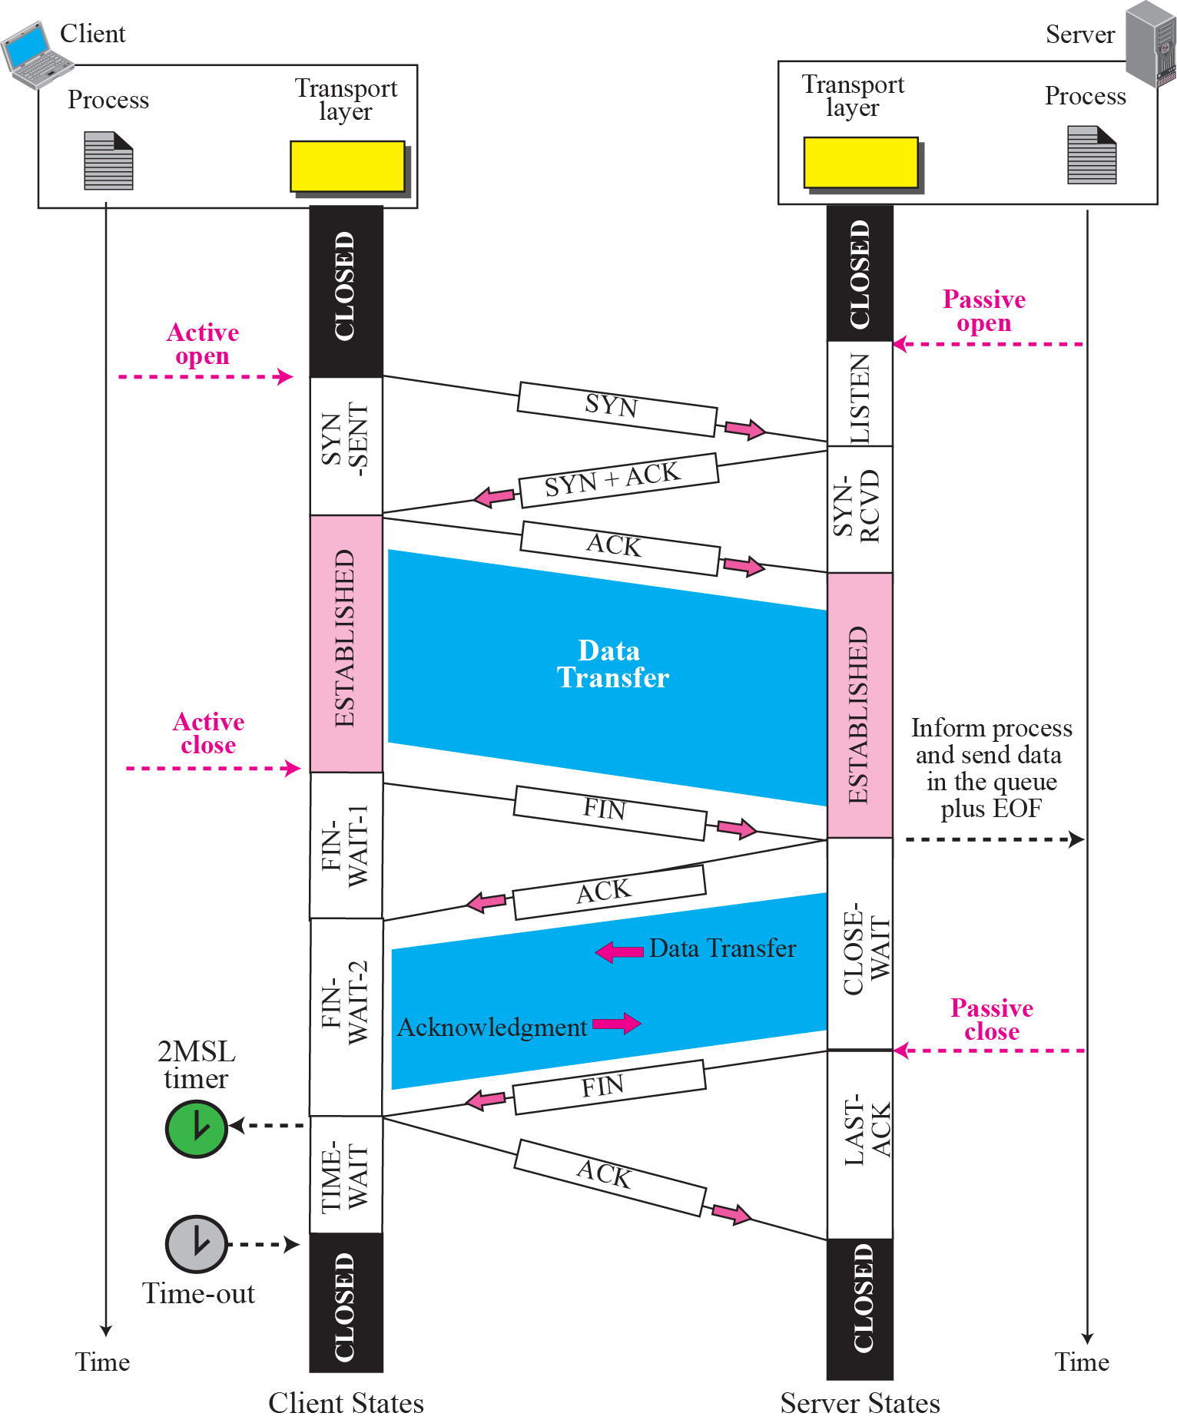
Figure 15.15 Time-line diagram for Figure 15.14
1. Enough time for an ACK to be lost and a new FIN to arrive. If during the TIME-WAIT state, a new FIN arrives, the client sends a new ACK and restarts the 2MSL timer
To prevent a duplicate segment from one connection appearing in the next one, TCP requires that incarnation cannot take place unless 2MSL amount of time has elapsed.
Another solution: the ISN of the incarnation is greater than the last seq. # used in the previous connection.
TCP/IP Protocol Suite
42
Notes:
42

Slide 43
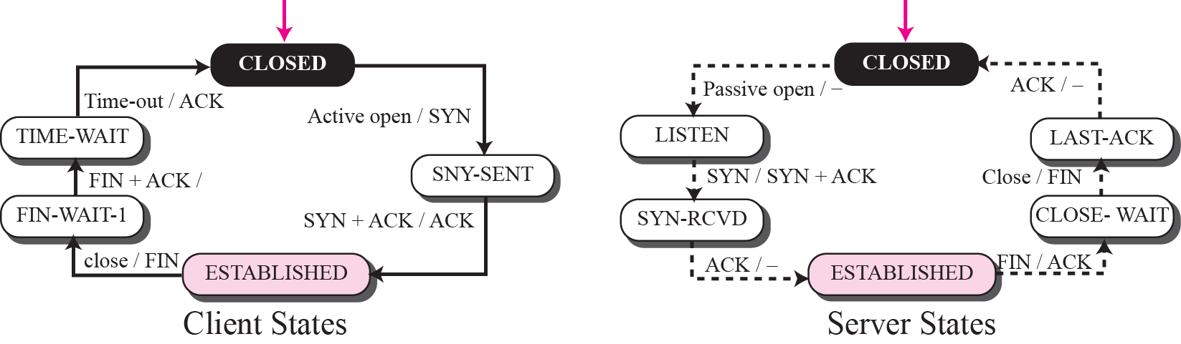
Figure 15.16 Transition diagram for a common scenario
TCP/IP Protocol Suite
43
Notes:
43

Slide 44
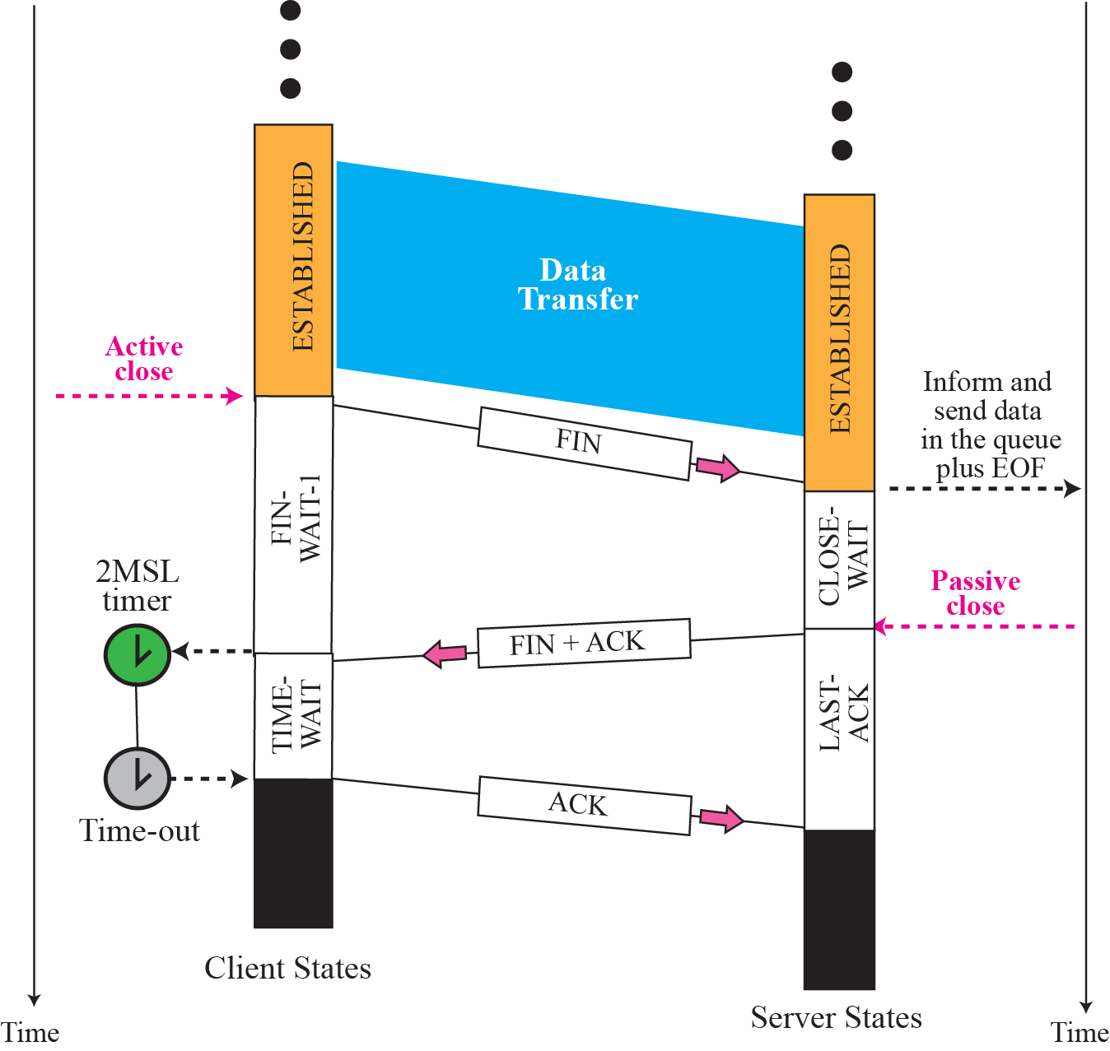
Figure 15.17 Time line for a common scenario
TCP/IP Protocol Suite
44
Notes:
44

Slide 45
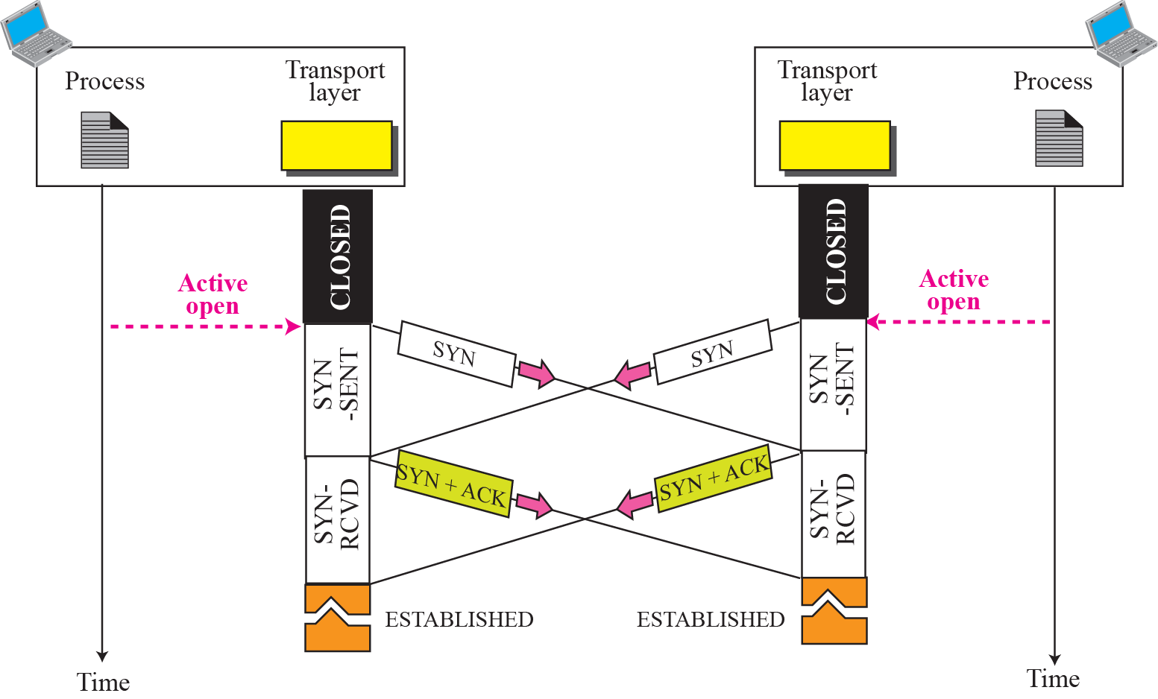
Figure 15.18 Simultaneous open
TCP/IP Protocol Suite
45
Notes:
45

Slide 46
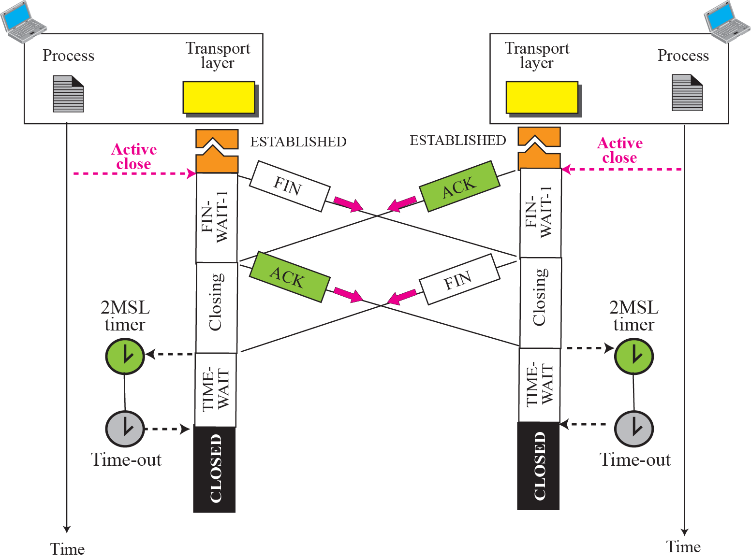
Figure 15.19 Simultaneous close
ex
TCP/IP Protocol Suite
46
Notes:
46

Slide 47
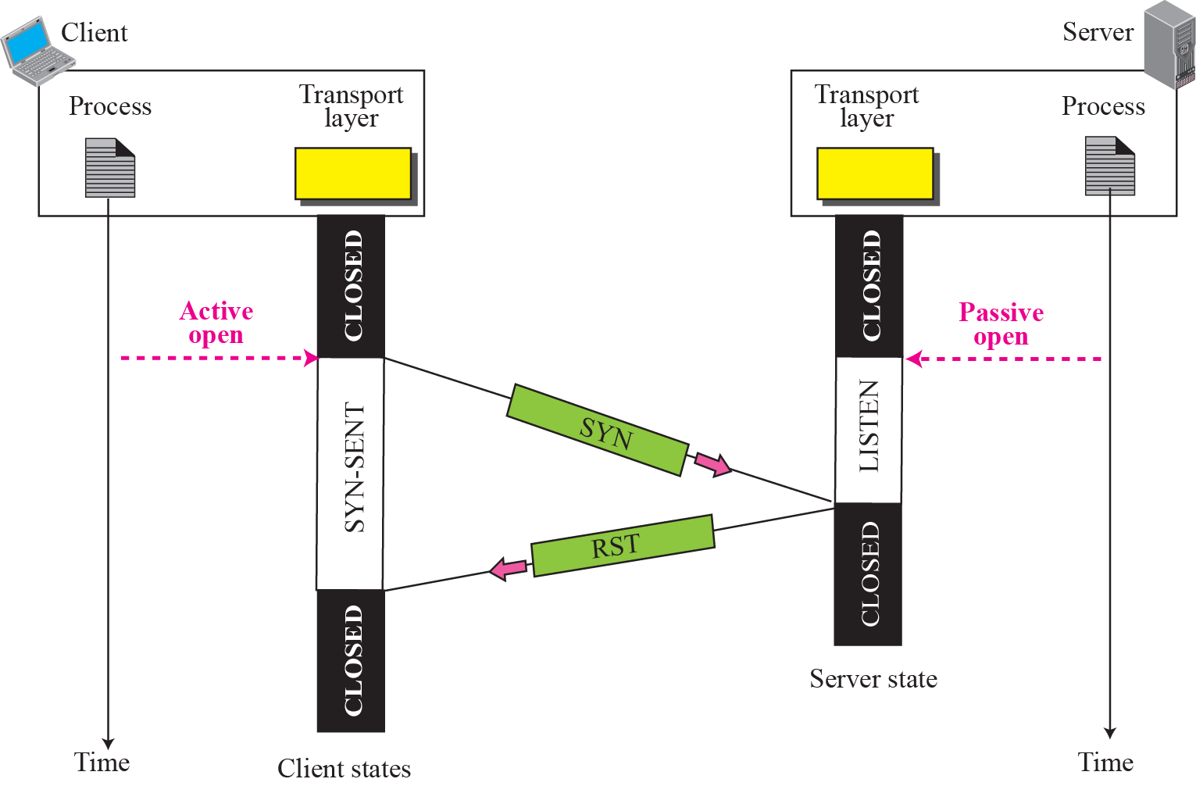
Figure 15.20 Denying a connection
TCP/IP Protocol Suite
47
Notes:
47

Slide 48
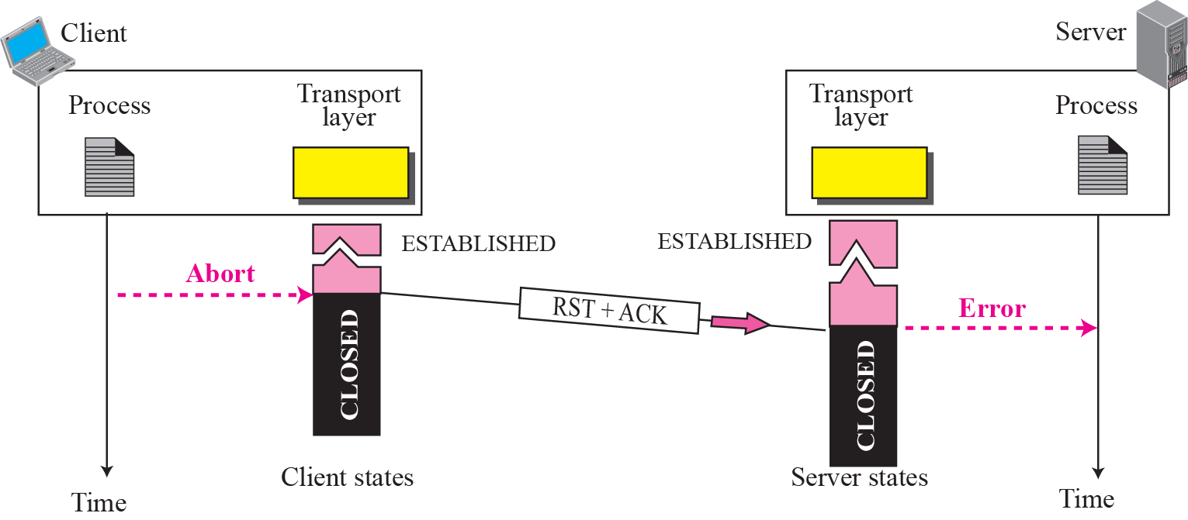
Figure 15.21 Aborting a connection
TCP/IP Protocol Suite
48
Notes:
48

Slide 49
15-6 WINDOWS IN TCP
Before discussing data transfer in TCP and the issues such as flow, error, and congestion control, we describe the windows used in TCP. TCP uses two windows (send window and receive window) for each direction of data transfer, which means four windows for a bidirectional communication. To make the discussion simple, we make an assumption that communication is only unidirectional; the bidirectional communication can be inferred using two unidirectional communications with piggybacking.
TCP/IP Protocol Suite
49
Notes:
49

Slide 50
Topics Discussed in the Section
Send Window
Receive Window
TCP/IP Protocol Suite
50
Notes:
50

Slide 51
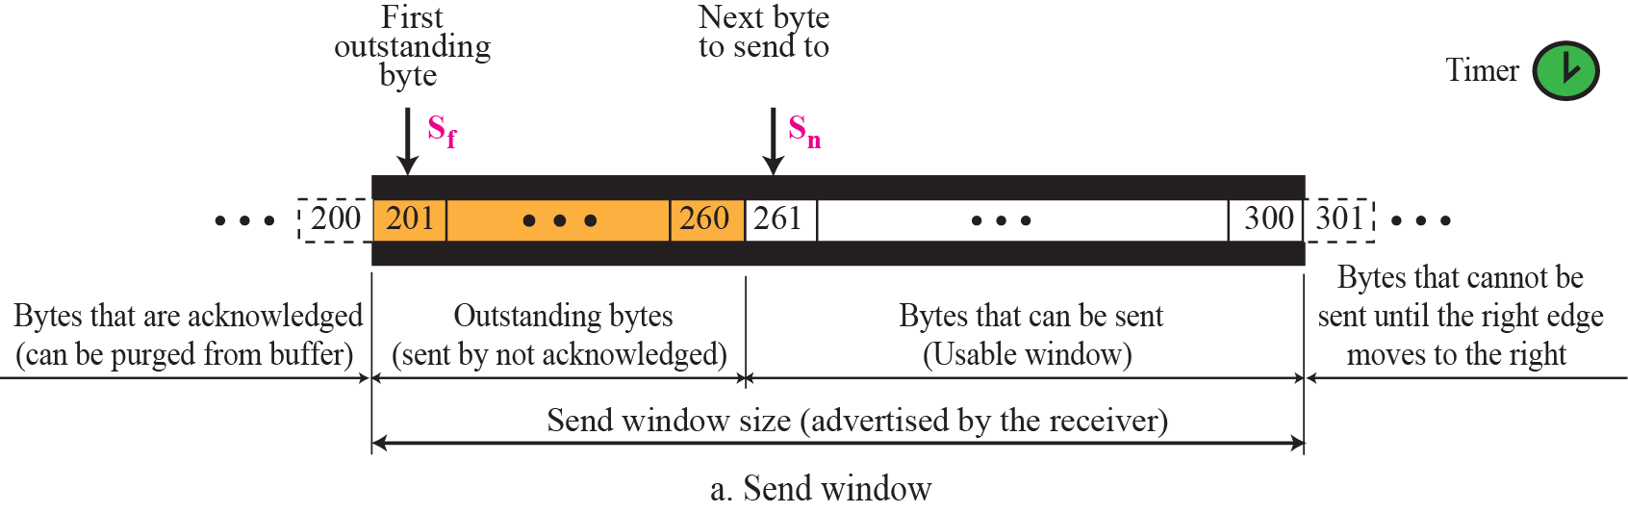
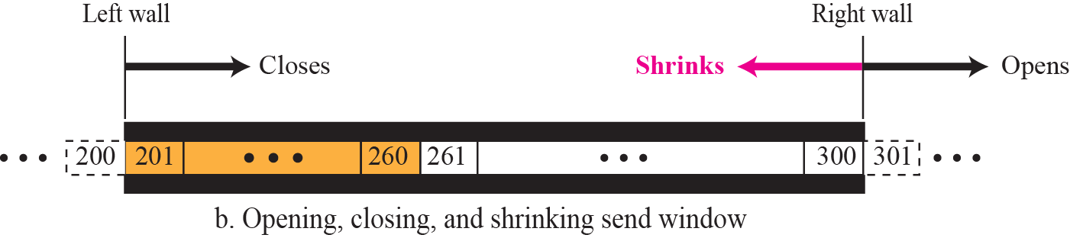
Figure 15.22 Send window in TCP
TCP/IP Protocol Suite
51
Notes:
51

Slide 52
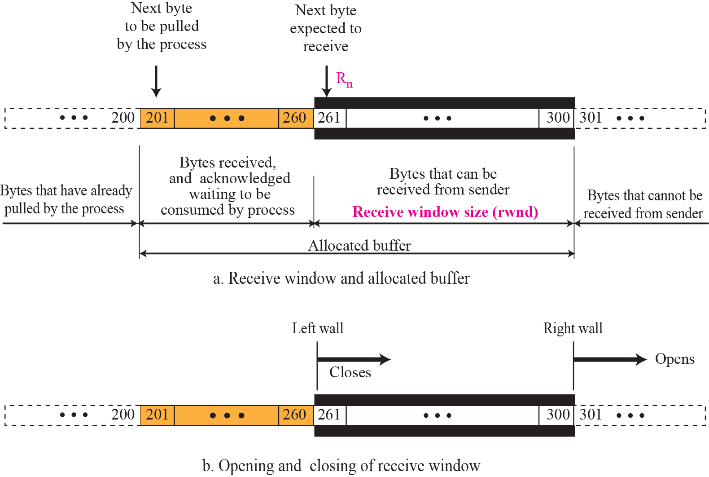
Figure 15.23 Receive window in TCP
TCP/IP Protocol Suite
52
Notes:
52

Slide 53
15-7 FLOW CONTROL
As discussed in Chapter 13, flow control balances the rate a producer creates data with the rate a consumer can use the data. TCP separates flow control from error control. In this section we discuss flow control, ignoring error control. We temporarily assume that the logical channel between the sending and receiving TCP is error-free. Figure 15.24 shows unidirectional data transfer between a sender and a receiver; bidirectional data transfer can be deduced from unidirectional one as discussed in Chapter 13.
TCP/IP Protocol Suite
53
Notes:
53

Slide 54
Topics Discussed in the Section
Opening and Closing Windows
Shrinking of Windows
Silly Window Syndrome
TCP/IP Protocol Suite
54
Notes:
54

Slide 55
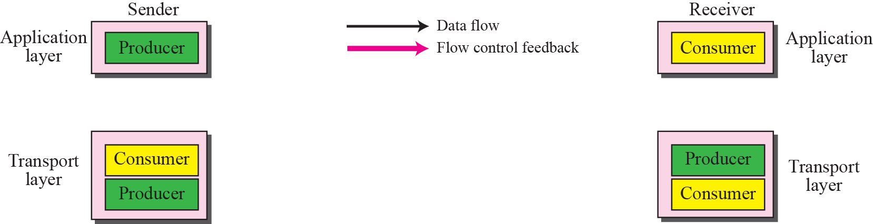
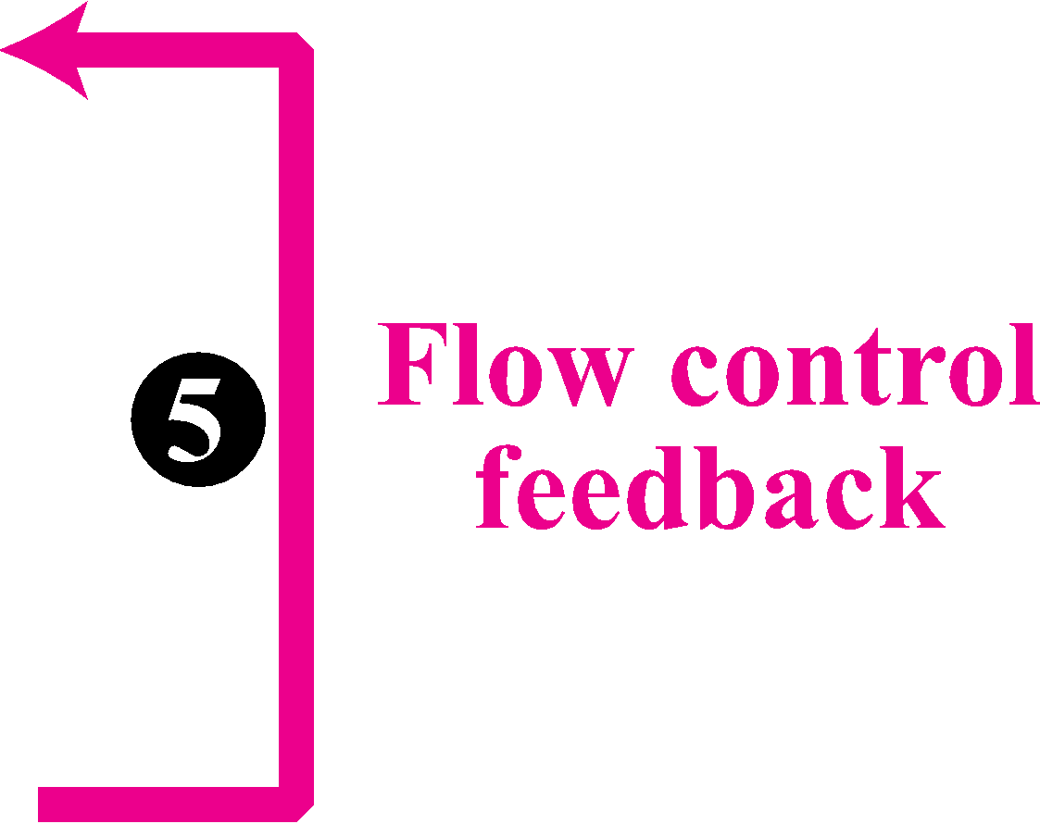
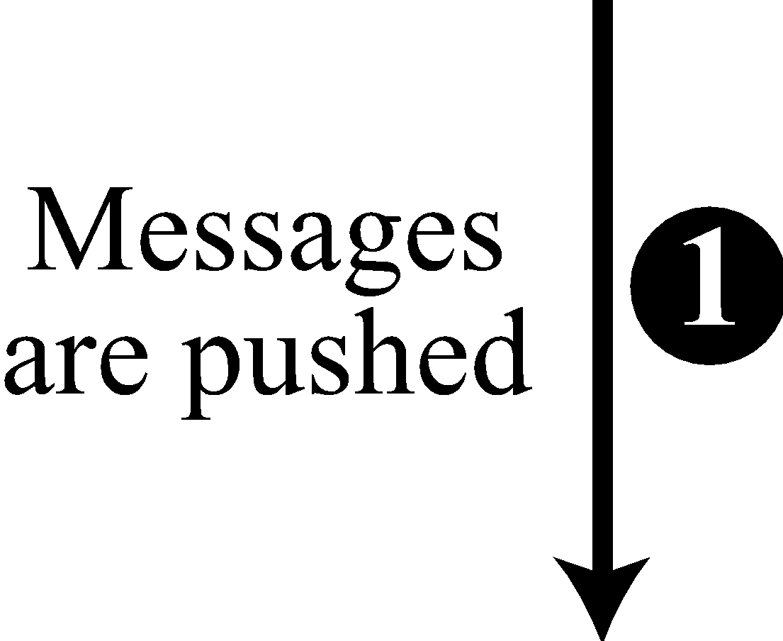
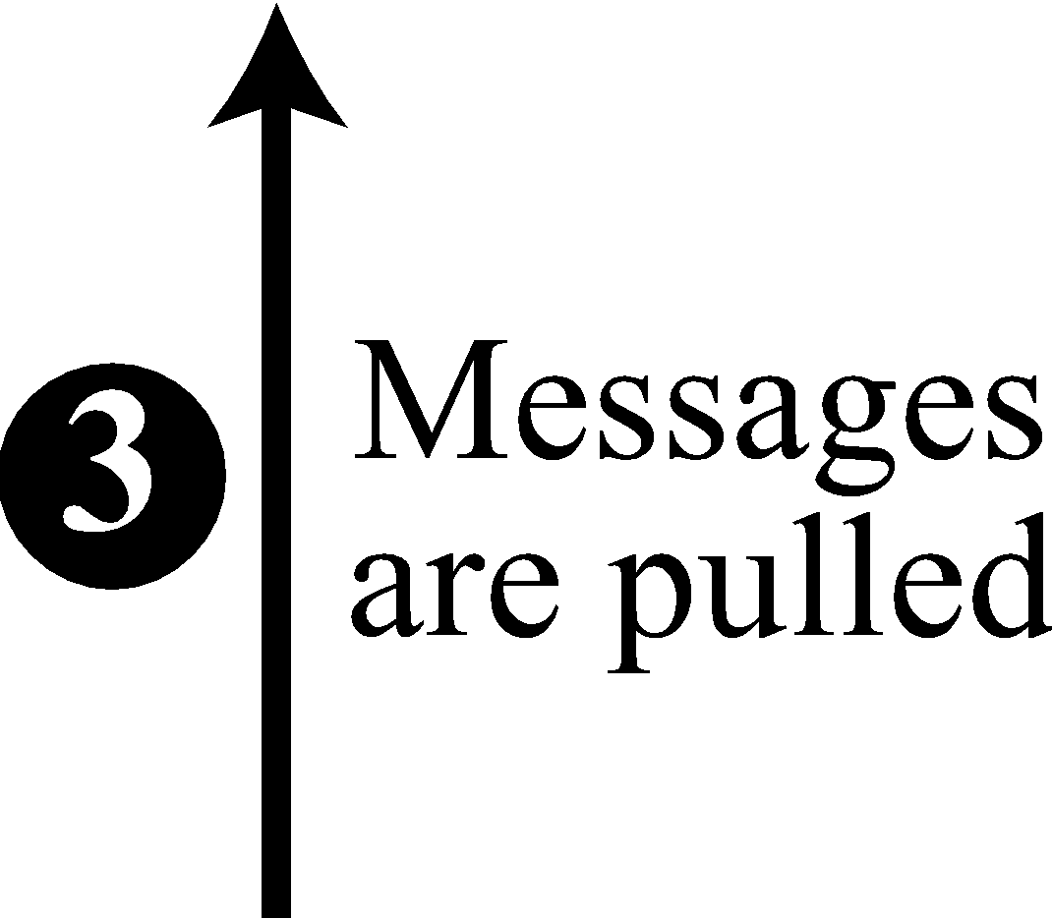
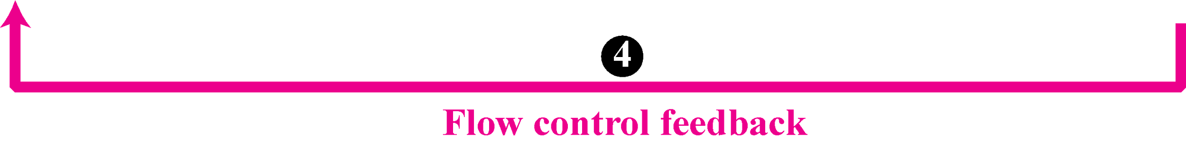
Figure 15.24 TCP/IP protocol suite
TCP/IP Protocol Suite
55
Notes:
55

Slide 56
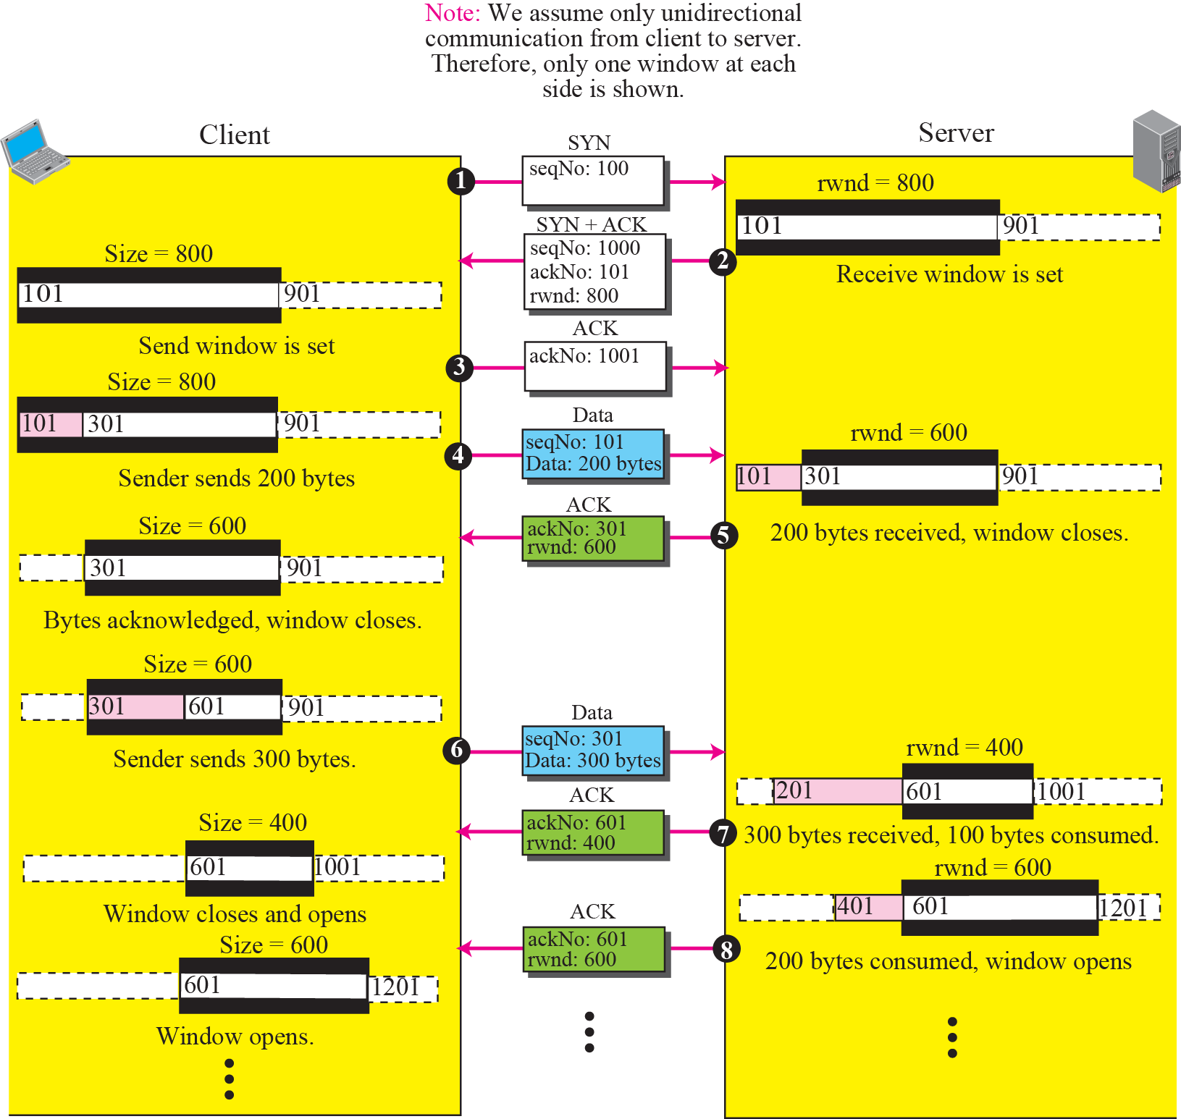
Figure 15.25 An example of flow control
TCP/IP Protocol Suite
56
Notes:
56

Slide 57
Example 15.2
Figure 15.26 shows the reason for the mandate in window shrinking. Part a of the figure shows values of last acknowledgment and rwnd. Part b shows the situation in which the sender has sent bytes 206 to 214. Bytes 206 to 209 are acknowledged and purged. The new advertisement, however, defines the new value of rwnd as 4, in which 210 + 4 < 206 + 12. When the send window shrinks, it creates a problem: byte 214 which has been already sent is outside the window. The relation discussed before forces the receiver to maintain the right-hand wall of the window to be as shown in part a because the receiver does not know which of the bytes 210 to 217 has already been sent. One way to prevent this situation is to let the receiver postpone its feedback until enough buffer locations are available in its window. In other words, the receiver should wait until more bytes are consumed by its process.
TCP/IP Protocol Suite
57
Notes:
57

Slide 58
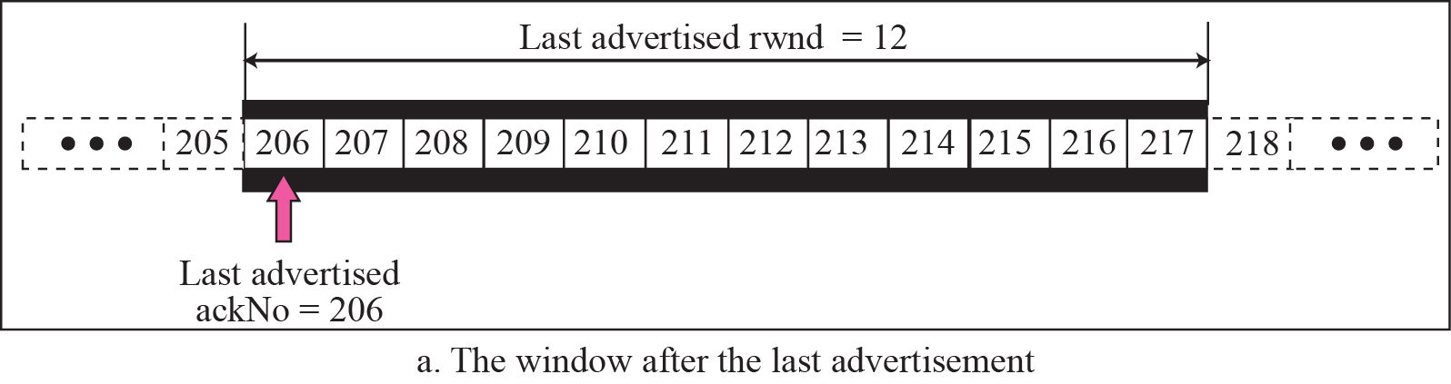
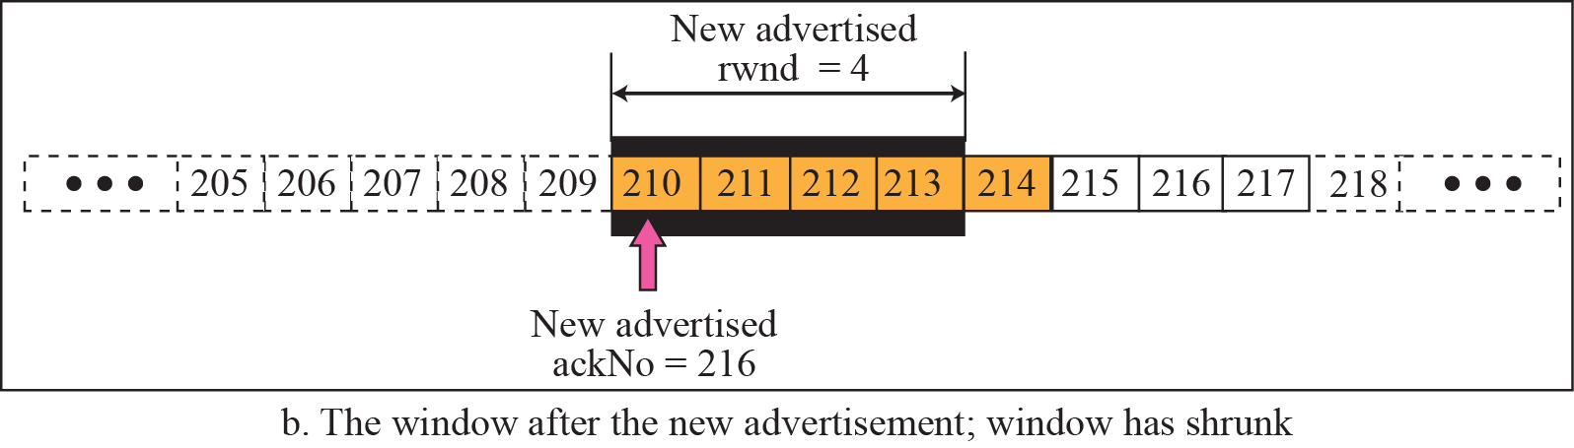
Figure 15.26 Example 15.2
Prevent the shrinking of the send window:
new ackNo + new rwnd >= last ackNo + last rwnd
?
210
TCP/IP Protocol Suite
58
Notes:
58

Slide 59
Silly Window Syndrome (1)
Sending data in very small segments
Syndrome created by the Sender
Sending application program creates data slowly (e.g. 1 byte at a time)
Wait and collect data to send in a larger block
How long should the sending TCP wait?
Solution: Nagle’s algorithm
Nagle’s algorithm takes into account (1) the speed of the application program that creates the data, and (2) the speed of the network that transports the data
TCP/IP Protocol Suite
59

Slide 60
Silly Window Syndrome (2)
Syndrome created by the Receiver
Receiving application program consumes data slowly (e.g. 1 byte at a time)
The receiving TCP announces a window size of 1 byte. The sending TCP sends only 1 byte…
Solution 1: Clark’s solution
Sending an ACK but announcing a window size of zero until there is enough space to accommodate a segment of max. size or until half of the buffer is empty
TCP/IP Protocol Suite
60

Slide 61
Silly Window Syndrome (3)
Solution 2: Delayed Acknowledgement
The receiver waits until there is decent amount of space in its incoming buffer before acknowledging the arrived segments
The delayed acknowledgement prevents the sending TCP from sliding its window. It also reduces traffic.
Disadvantage: it may force the sender to retransmit the unacknowledged segments
To balance: should not be delayed by more than 500ms
TCP/IP Protocol Suite
61

Slide 62
15-8 ERROR CONTROL
TCP is a reliable transport layer protocol. This means that an application program that delivers a stream of data to TCP relies on TCP to deliver the entire stream to the application program on the other end in order, without error, and without any part lost or duplicated.
Error control in TCP is achieved through the use of three tools: checksum, acknowledgment, and time-out.
TCP/IP Protocol Suite
62
Notes:
62

Slide 63
Topics Discussed in the Section
Checksum
Acknowledgment
Retransmission
Out-of-Order Segments
FSMs for Data Transfer in TCP
Some Scenarios
TCP/IP Protocol Suite
63
Notes:
63

Slide 64
Note
ACK segments do not consume sequence numbers and
are not acknowledged.
TCP/IP Protocol Suite
64
Notes:
64

Slide 65
Acknowledgement Type
In the past, TCP used only one type of acknowledgement: Accumulative Acknowledgement (ACK), also namely accumulative positive acknowledgement
More and more implementations are adding another type of acknowledgement: Selective Acknowledgement (SACK), SACK is implemented as an option at the end of the TCP header.
TCP/IP Protocol Suite
65

Slide 66
Note
Data may arrive out of order and be temporarily stored by the receiving TCP,
but TCP guarantees that no out-of-order data are delivered to the process.
TCP/IP Protocol Suite
66
Notes:
66

Slide 67
Note
TCP can be best modeled as a Selective Repeat protocol.
TCP/IP Protocol Suite
67
Notes:
67

Slide 68
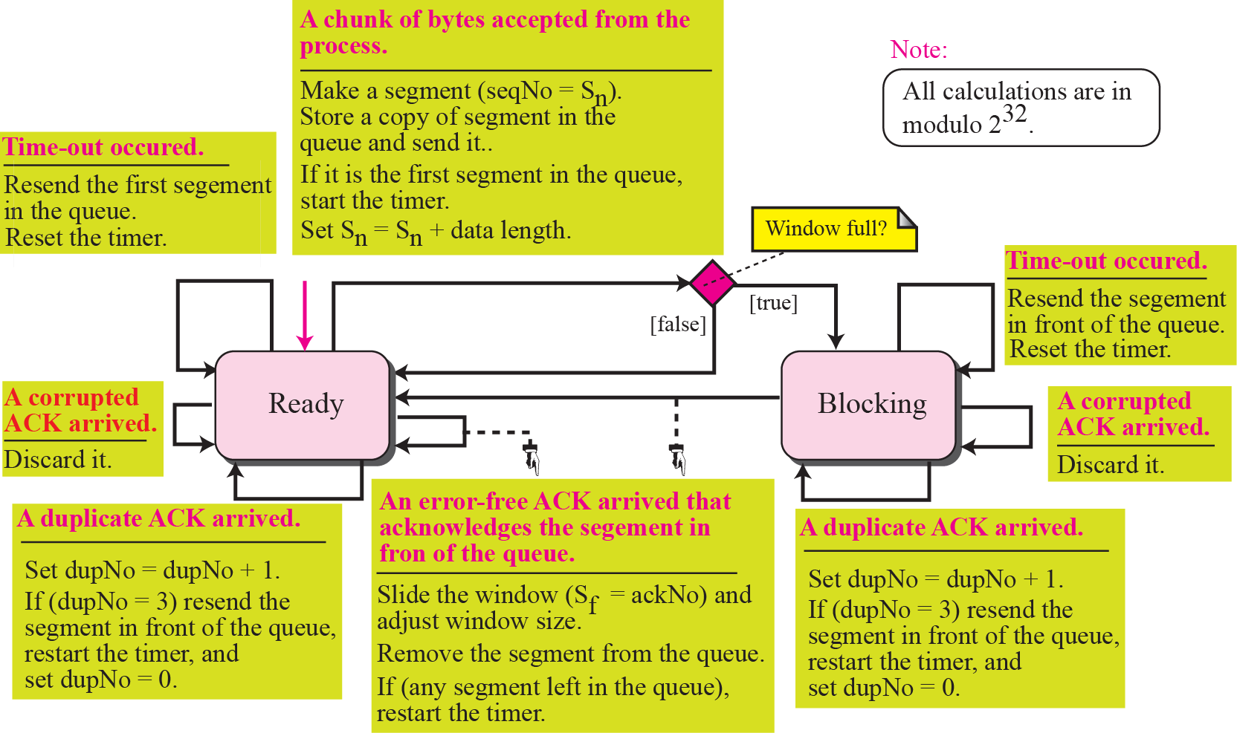
Figure 15.27 Simplified FSM for sender site
TCP/IP Protocol Suite
68
Notes:
68

Slide 69
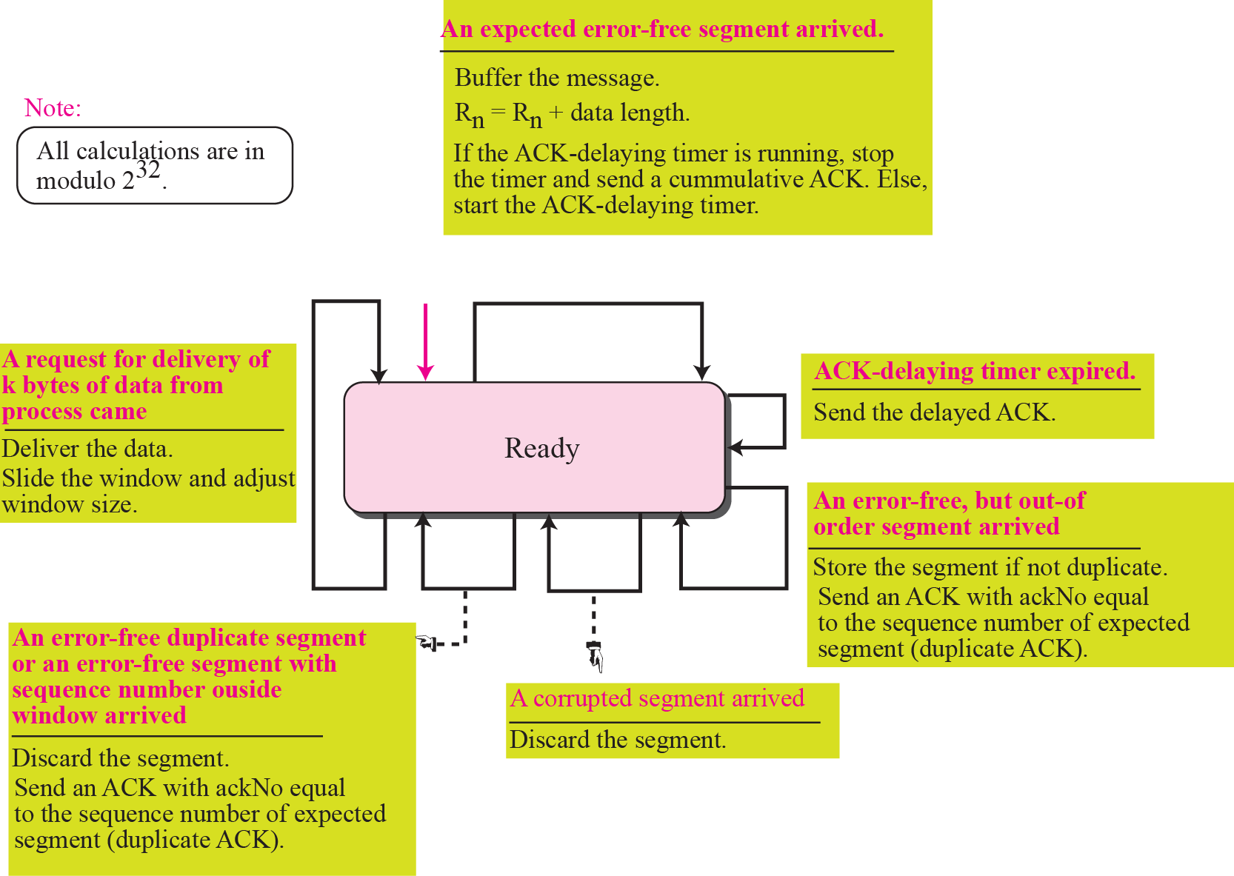
Figure 15.28 Simplified FSM for the receiver site
TCP/IP Protocol Suite
69
Notes:
69

Slide 70
Rules for Generating ACK (1)
1. When one end sends a data segment to the other end, it must include an ACK. That gives the next sequence number it expects to receive. (Piggyback)
2. The receiver needs to delay sending (until another segment arrives or 500ms) an ACK segment if there is only one outstanding in-order segment. It prevents ACK segments from creating extra traffic.
3. There should not be more than 2 in-order unacknowledged segments at any time. It prevent the unnecessary retransmission
TCP/IP Protocol Suite
70

Slide 71
Rules for Generating ACK (2)
4. When a segment arrives with an out-of-order sequence number that is higher than expected, the receiver immediately sends an ACK segment announcing the sequence number of the next expected segment. (for fast retransmission)
5. When a missing segment arrives, the receiver sends an ACK segment to announce the next sequence number expected.
6. If a duplicate segment arrives, the receiver immediately sends an ACK.
TCP/IP Protocol Suite
71

Slide 72
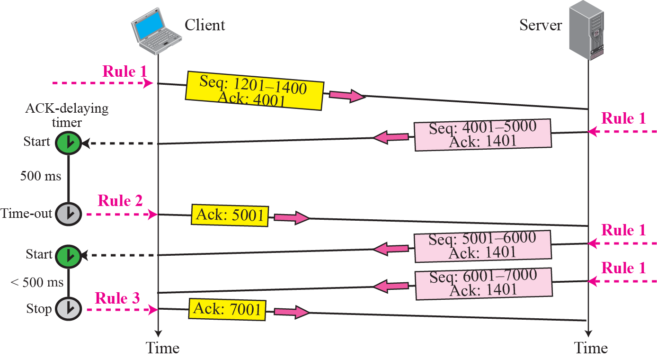
Figure 15.29 Normal operation
TCP/IP Protocol Suite
72
Notes:
72

Slide 73
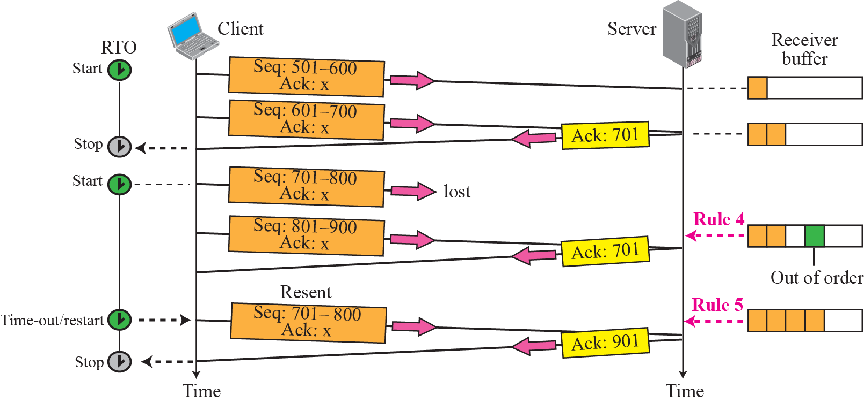
Figure 15.30 Lost segment
TCP/IP Protocol Suite
73
Notes:
73

Slide 74
Note
The receiver TCP delivers only ordered data to the process.
TCP/IP Protocol Suite
74
Notes:
74

Slide 75






Figure 15.31 Fast retransmission
TCP/IP Protocol Suite
75
Notes:
75

Slide 76

Figure 15.32 Lost acknowledgment
TCP/IP Protocol Suite
76
Notes:
76

Slide 77

Figure 15.33 Lost acknowledgment corrected by resending a segment
TCP/IP Protocol Suite
77
Notes:
77

Slide 78
Note
Lost acknowledgments may create deadlock if they are not
properly handled.
TCP/IP Protocol Suite
78
Notes:
78

Slide 79
15-9 CONGESTION CONTROL
We discussed congestion control in Chapter 13. Congestion control in TCP is based on both open loop and closed-loop mechanisms. TCP uses a congestion window and a congestion policy that avoid congestion and detect and alleviate congestion after it has occurred.
TCP/IP Protocol Suite
79
Notes:
79

Slide 80
Topics Discussed in the Section
Congestion Window
Congestion Policy
TCP/IP Protocol Suite
80
Notes:
80

Slide 81











Figure 15.34 Slow start, exponential increase
TCP/IP Protocol Suite
81
Notes:
81

Slide 82
Note
In the slow start algorithm, the size of the congestion window increases exponentially until it reaches a threshold.
TCP/IP Protocol Suite
82
Notes:
82

Slide 83

Figure 15.35 Congestion avoidance, additive increase
TCP/IP Protocol Suite
83
Notes:
83

Slide 84
Note
In the congestion avoidance algorithm the size of the congestion window
increases additively until
congestion is detected.
TCP/IP Protocol Suite
84
Notes:
84

Slide 85

Figure 15.36 TCP Congestion policy summary
TCP/IP Protocol Suite
85
Notes:
85

Slide 86

Figure 15.37 Congestion example
TCP/IP Protocol Suite
86
Notes:
86

Slide 87
15-10 TCP TIMERS
To perform its operation smoothly, most TCP implementations use at least four timers as shown in Figure 15.38 (slide 83).
TCP/IP Protocol Suite
87
Notes:
87

Slide 88
Topics Discussed in the Section
Retransmission Timer
Persistence Timer
Keepalive Timer
TIME-WAIT Timer
TCP/IP Protocol Suite
88
Notes:
88

Slide 89

Figure 15.38 TCP timers
TCP/IP Protocol Suite
89
Notes:
89

Slide 90
Note
In TCP, there can be only one RTT measurement in progress at any time.
Since the segments and their ACKs do not have a 1-1 relationship
TCP/IP Protocol Suite
90
Notes:
90

Slide 91
Calculation of RTO (1)
Smoothed RTT: RTT_{S}
Original 🡪 No value
After 1st measurement 🡪 RTT_{S} = RTT_{M}
2nd … 🡪 RTT_{S} = (1-α)*RTT_{S} + α*RTT_{M}
RTT Deviation : RTT_{D}
Original 🡪 No value
After 1st measurement 🡪 RTT_{D} = 0.5*RTT_{M}
2nd … 🡪 RTT_{D} = (1-β)*RTT_{D} + β*|RTT_{S} - RTT_{M}|
TCP/IP Protocol Suite
91

Slide 92
Calculation of RTO (2)
Retransmission Timeout (RTO)
Original 🡪 Initial value
After any measurement 🡪 RTO = RTT_{S} + 4RTT_{D}
Example 10 (page 322)
α = 1/8
β = 1/4
TCP/IP Protocol Suite
92

Slide 93


Example 15.3
Let us give a hypothetical example. Figure 15.39 shows part of a connection. The figure shows the connection establishment and part of the data transfer phases.
1. When the SYN segment is sent, there is no value for RTTM, RTTS, or RTTD. The value of RTO is set to 6.00 seconds. The following shows the value of these variable at this moment:
2. When the SYN+ACK segment arrives, RTTM is measured and is equal to 1.5 seconds.
TCP/IP Protocol Suite
93
Notes:
93

Slide 94

Example 15.3 Continued
3. When the first data segment is sent, a new RTT measurement starts. No RTT measurement starts for the second data segment because a measurement is already in progress. The arrival of the last ACK segment is used to calculate the next value of RTTM. Although the last ACK segment acknowledges both data segments (cumulative), its arrival finalizes the value of RTTM for the first segment. The values of these variables are now as shown below.
TCP/IP Protocol Suite
94
Notes:
94

Slide 95

Figure 15.39 Example 15.3
TCP/IP Protocol Suite
95
Notes:
95

Slide 96
Note
TCP does not consider the RTT of a retransmitted segment in its calculation of a new RTO.
TCP/IP Protocol Suite
96
Notes:
96

Slide 97
Example 15.4
Figure 15.40 is a continuation of the previous example. There is retransmission and Karn’s algorithm is applied.
The first segment in the figure is sent, but lost. The RTO timer expires after 4.74 seconds. The segment is retransmitted and the timer is set to 9.48, twice the previous value of RTO. This time an ACK is received before the time-out. We wait until we send a new segment and receive the ACK for it before recalculating the RTO (Karn’s algorithm).
TCP/IP Protocol Suite
97
Notes:
97

Slide 98

Figure 15.40 Example 15.4
TCP/IP Protocol Suite
98
Notes:
98

Slide 99
15-11 OPTIONS
The TCP header can have up to 40 bytes of optional information. Options convey additional information to the destination or align other options. We can define two categories of options: 1-byte options and multiple-byte options. The first category contains two types of options: end of option list and no operation. The second category, in most implementations, contains five types of options: maximum segment size, window scale factor, timestamp, SACK-permitted, and SACK (see Figure 15.41).
TCP/IP Protocol Suite
99
Notes:
99

Slide 100

Figure 15.41 Options
TCP/IP Protocol Suite
100
Notes:
100

Slide 101

Figure 15.42 End-of-option option
TCP/IP Protocol Suite
101
Notes:
101

Slide 102
Note
EOP can be used only once.
TCP/IP Protocol Suite
102
Notes:
102

Slide 103

Figure 15.43 No-operation option
TCP/IP Protocol Suite
103
Notes:
103

Slide 104
Note
NOP can be used more than once.
TCP/IP Protocol Suite
104
Notes:
104

Slide 105

Figure 15.44 Minimum-segment-size option
TCP/IP Protocol Suite
105
Notes:
105

Slide 106
Note
The value of MSS is determined during connection establishment and does not change during the connection.
TCP/IP Protocol Suite
106
Notes:
106

Slide 107

Figure 15.45 Window-scale-factor option
TCP/IP Protocol Suite
107
Notes:
107

Slide 108
Note
The value of the window scale factor can be determined only during connection
establishment; it does not change during the connection.
TCP/IP Protocol Suite
108
Notes:
108

Slide 109

Figure 15.46 Timestamp option
TCP/IP Protocol Suite
109
Notes:
109

Slide 110
Note
One application of the timestamp option is the calculation of round-trip time (RTT).
TCP/IP Protocol Suite
110
Notes:
110

Slide 111
Example 15.5
Figure 15.47 shows an example that calculates the round-trip time for one end. Everything must be flipped if we want to calculate the RTT for the other end.
TCP/IP Protocol Suite
111
Notes:
111

Slide 112

Figure 15.47 Example 15.5
TCP/IP Protocol Suite
112
Notes:
112

Slide 113
Note
The timestamp option can also be used for PAWS.
TCP/IP Protocol Suite
113
Notes:
113

Slide 114

Figure 15.48 SACK
TCP/IP Protocol Suite
114
Notes:
114

Slide 115
Example 15.6
Let us see how the SACK option is used to list out-of-order blocks. In Figure 15.49 an end has received five segments of data.
TCP/IP Protocol Suite
115
Notes:
115

Slide 116

Figure 15.49 Example 15.6
TCP/IP Protocol Suite
116
Notes:
116

Slide 117
Example 15.7
Figure 15.50 shows how a duplicate segment can be detected with a combination of ACK and SACK. In this case, we have some out-of-order segments (in one block) and one duplicate segment. To show both out-of-order and duplicate data, SACK uses the first block, in this case, to show the duplicate data and other blocks to show out-of-order data. Note that only the first block can be used for duplicate data. The natural question is how the sender, when it receives these ACK and SACK values, knows that the first block is for duplicate data (compare this example with the previous example). The answer is that the bytes in the first block are already acknowledged in the ACK field; therefore, this block must be a duplicate.
TCP/IP Protocol Suite
117
Notes:
117

Slide 118

Figure 15.50 Example 15.7
TCP/IP Protocol Suite
118
Notes:
118

Slide 119
Example 15.8
Figure 15.51 shows what happens if one of the segments in the out-of-order section is also duplicated. In this example, one of the segments (4001:5000) is duplicated.
The SACK option announces this duplicate data first and then the out-of-order block. This time, however, the duplicated block is not yet acknowledged by ACK, but because it is part of the out-of-order block (4001:5000 is part of 4001:6000), it is understood by the sender that it defines the duplicate data.
TCP/IP Protocol Suite
119
Notes:
119

Slide 120

Figure 15.51 Example 15.8
TCP/IP Protocol Suite
120
Notes:
120

Slide 121
15-12 TCP PACKAGE
The TCP header can have up to 40 bytes of optional information. Options convey additional information to the destination or align other options. We can define two categories of options: 1-byte options and multiple-byte options. The first category contains two types of options: end of option list and no operation. The second category, in most implementations, contains five types of options: maximum segment size, window scale factor, timestamp, SACK-permitted, and SACK (see Figure 15.41).
TCP/IP Protocol Suite
121
Notes:
121

Slide 122
Topics Discussed in the Section
Transmission Control Block TCBs
Timers
Main Module
Input Processing Module
Output Processing Module
TCP/IP Protocol Suite
122
Notes:
122

Slide 123

Figure 15.52 TCBs
TCP/IP Protocol Suite
123
Notes:
123

Slide 124

Figure 15.53 TCP/IP protocol suite
TCP/IP Protocol Suite
124
Notes:
124

Slide 125


TCP/IP Protocol Suite
125
Notes:
125

Slide 126


TCP/IP Protocol Suite
126
Notes:
126

Slide 127

TCP/IP Protocol Suite
127
Notes:
127

Slide 128

TCP/IP Protocol Suite
128
Notes:
128

Slide 129


TCP/IP Protocol Suite
129
Notes:
129

Slide 130

TCP/IP Protocol Suite
130
Notes:
130

Slide 131


TCP/IP Protocol Suite
131
Notes:
131

Slide 132

TCP/IP Protocol Suite
132
Notes:
132

